Slide 1
Azure Logic Apps
In this we are going to copy data from Azure Blob storage > ADF > Azure SQL Database by using copy data. We are going to send email to respective email id whether the pipeline has failed or successful

Slide 2
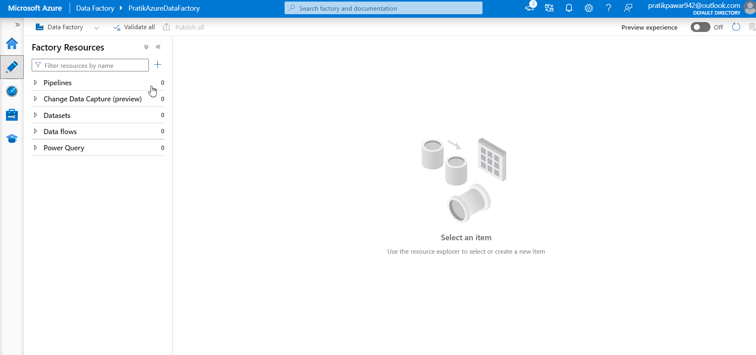
First Create Azure Blob Storage, ADF and SQL Server Database(data is already present in Azure SQL and we are adding new data from Azure blob storage)

Slide 3
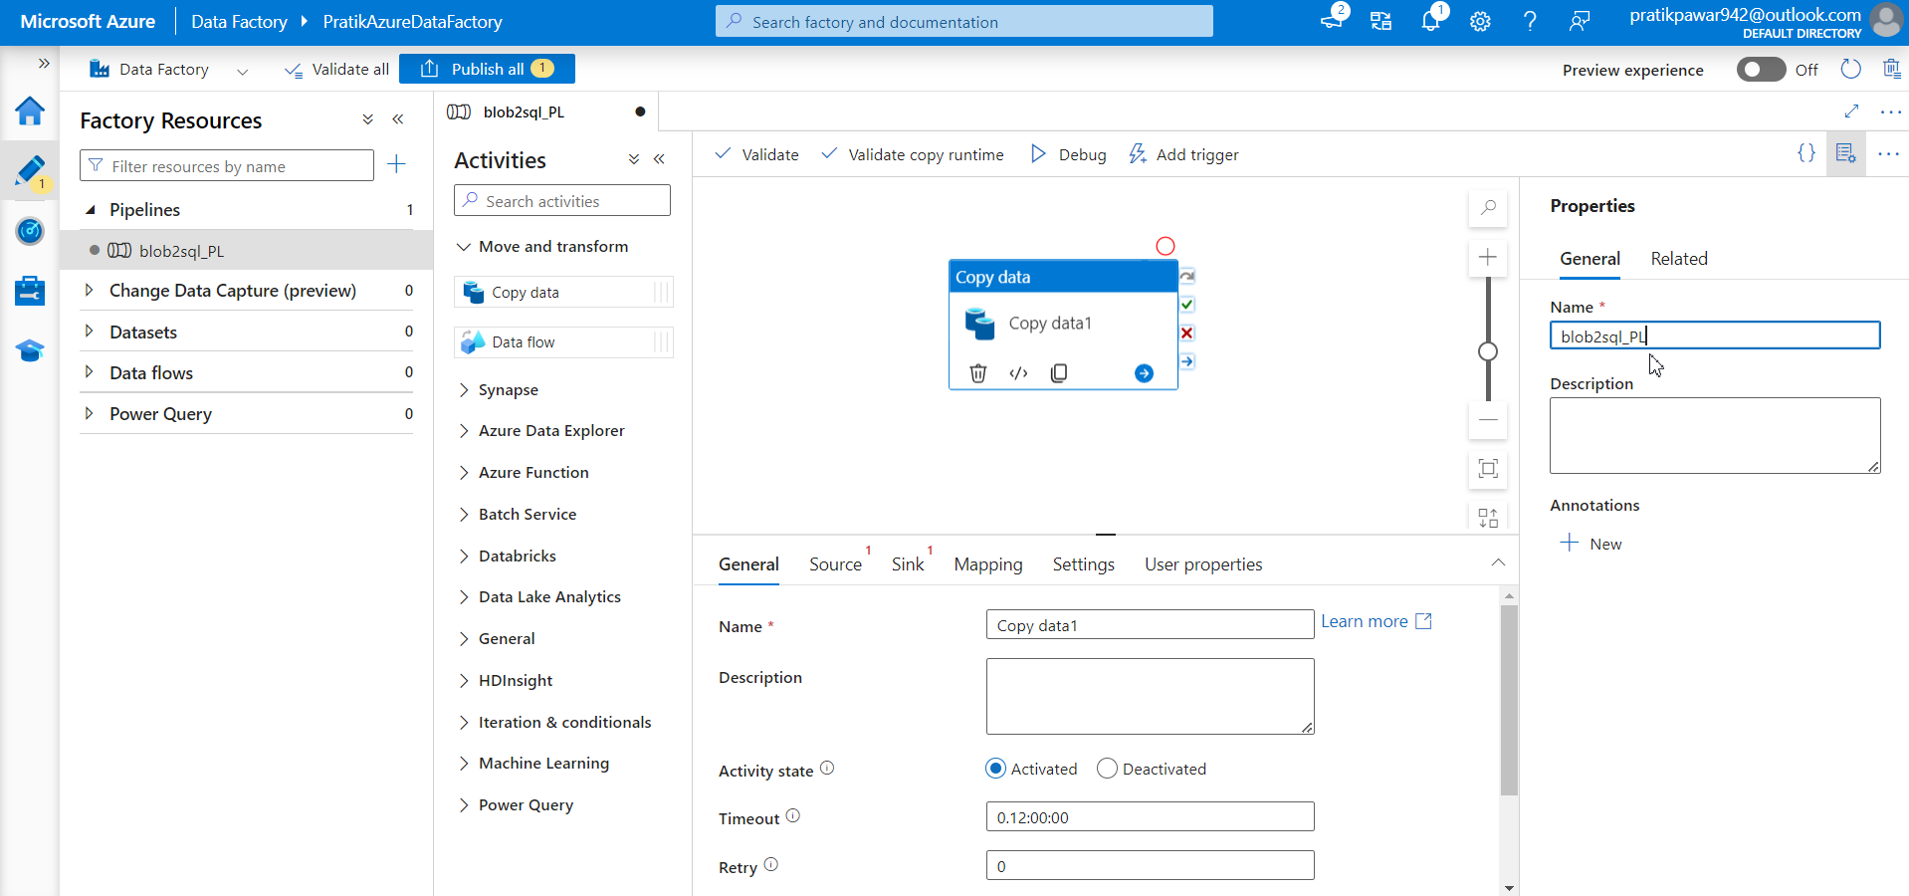
Create pipeline and name it

Slide 4
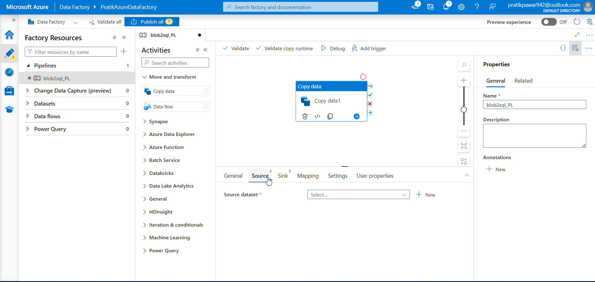
Add source : Blob Storage and Sink : Azure SQL Database

Slide 5
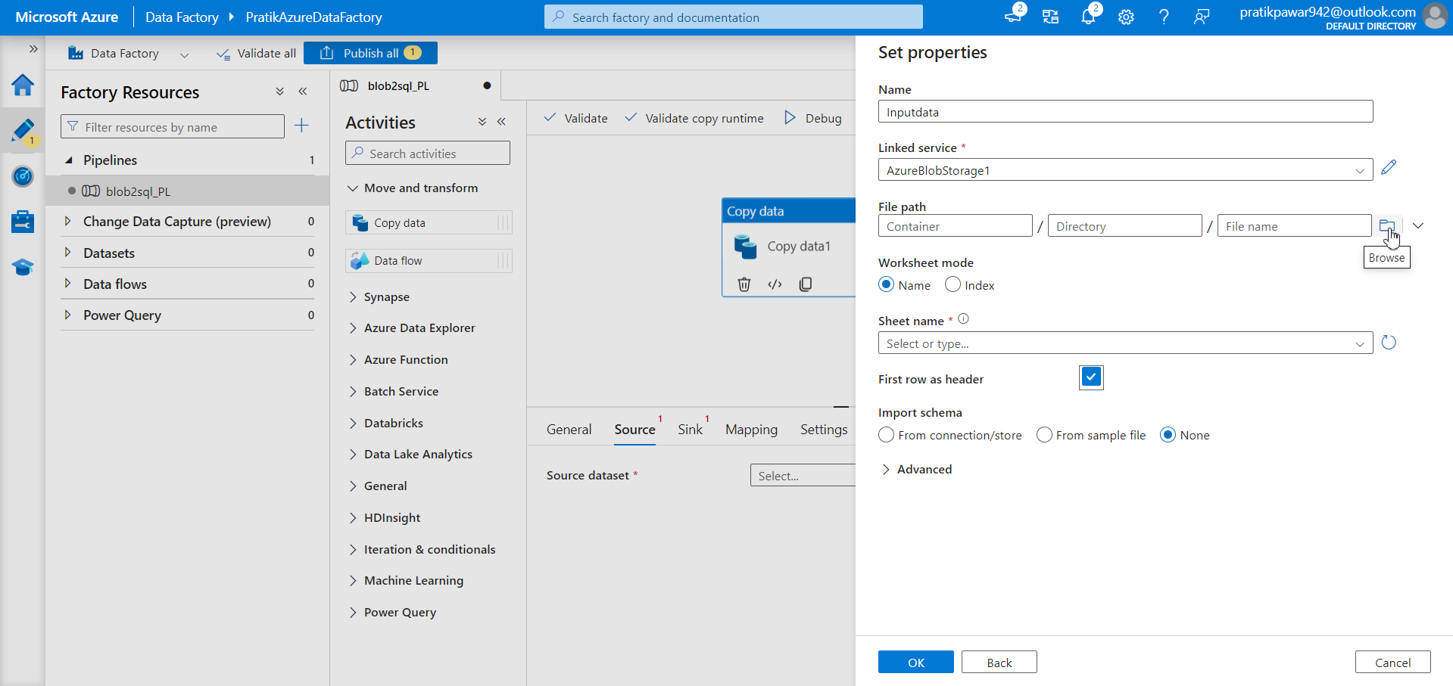
After connection add file from blob storage

Slide 6
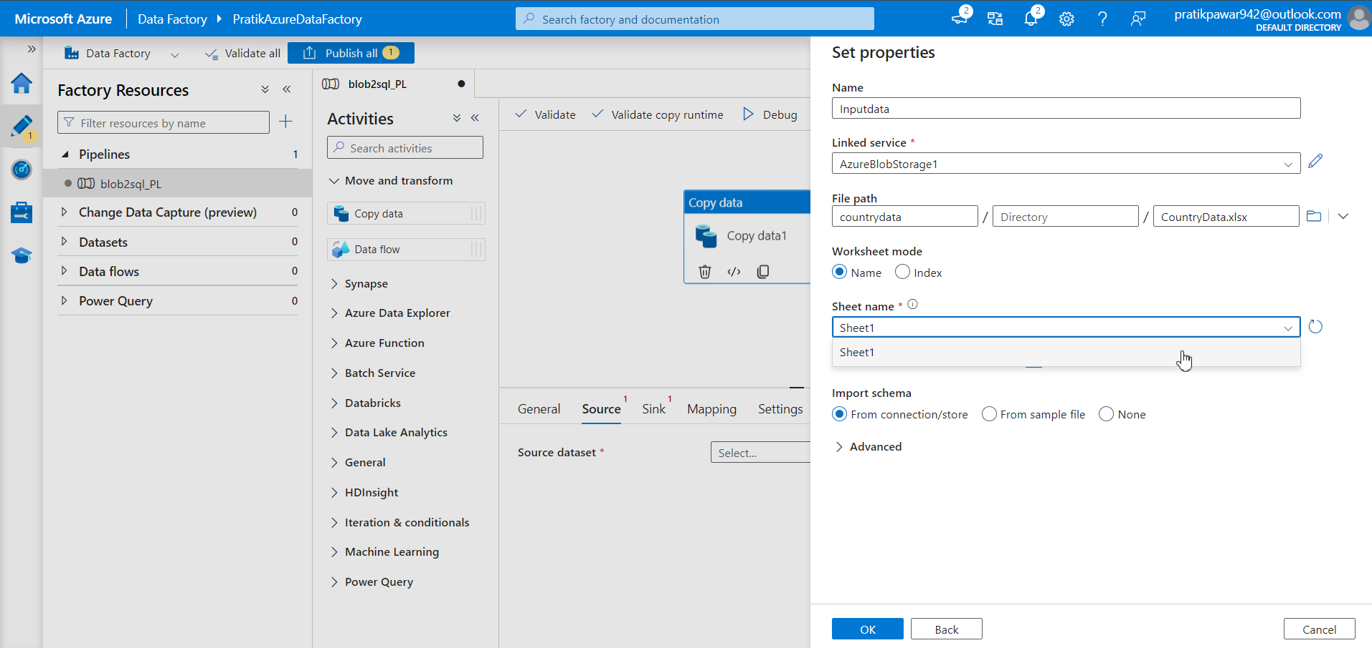
Select sheet name

Slide 7
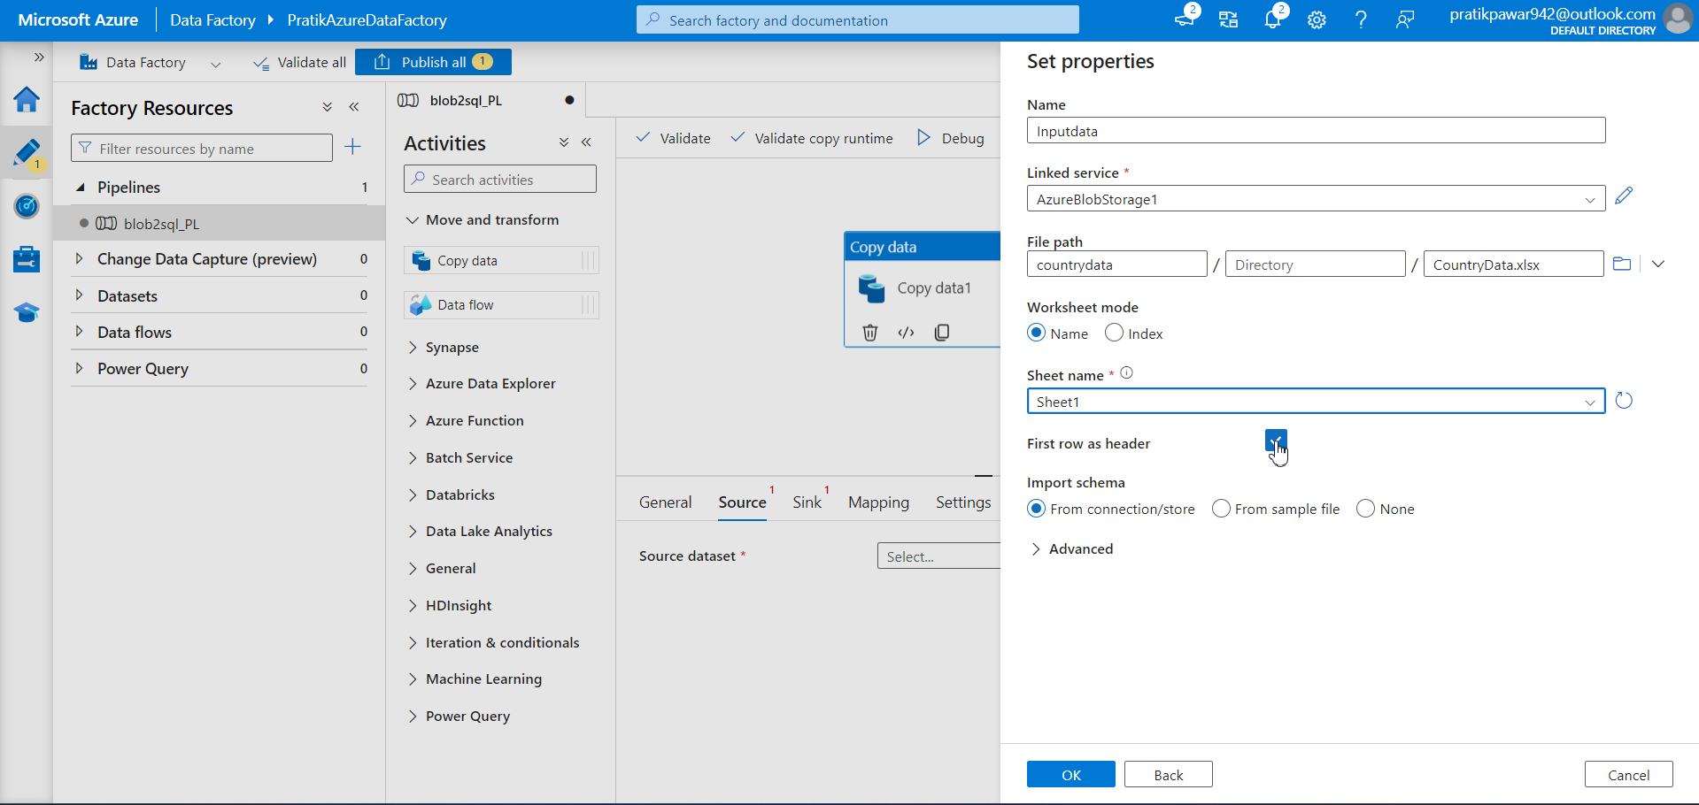
First Row as header

Slide 8
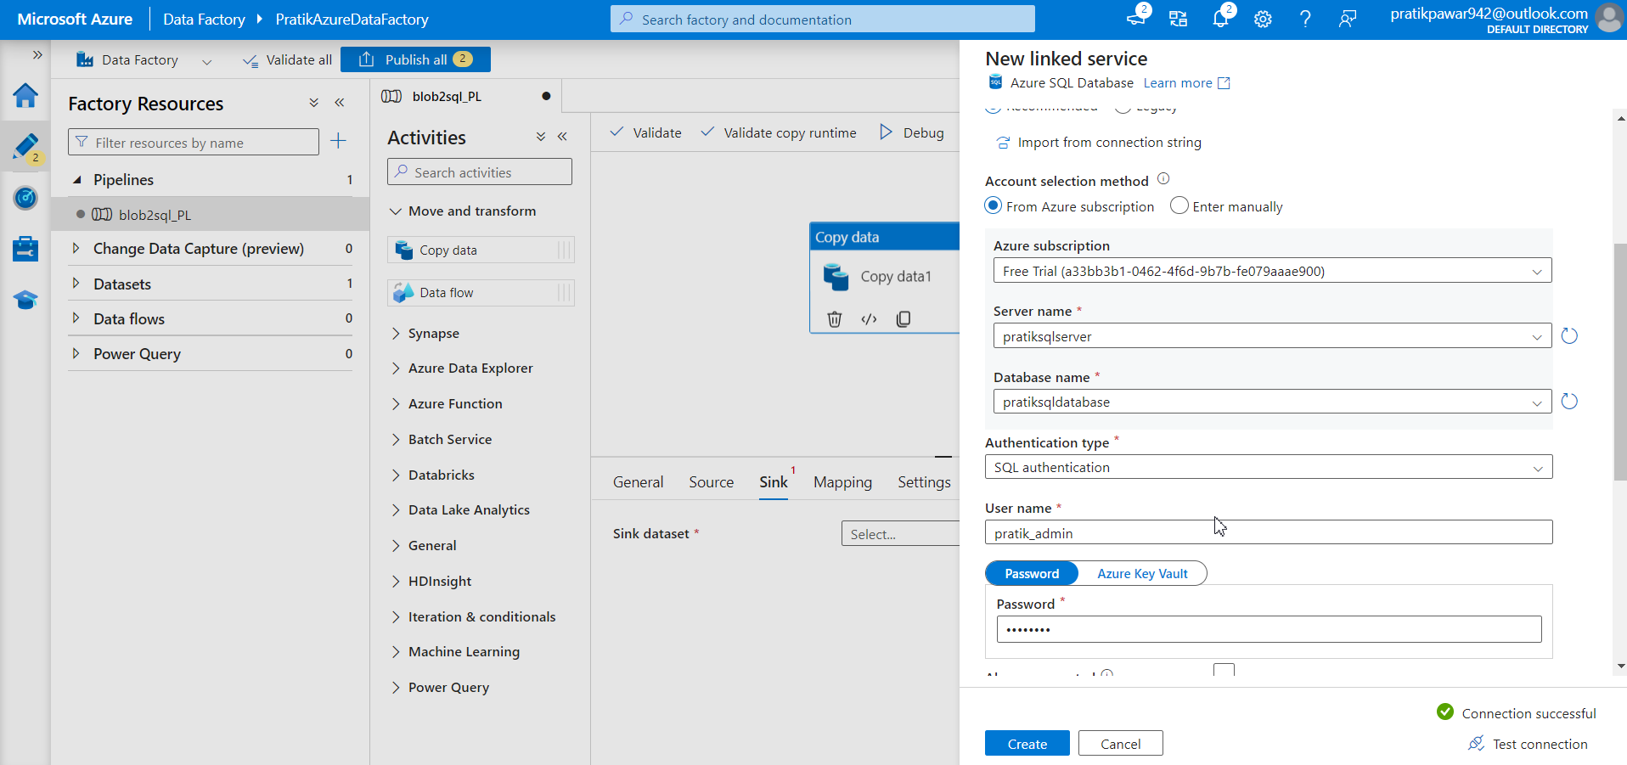
Add sink Azure SQL Database

Slide 9
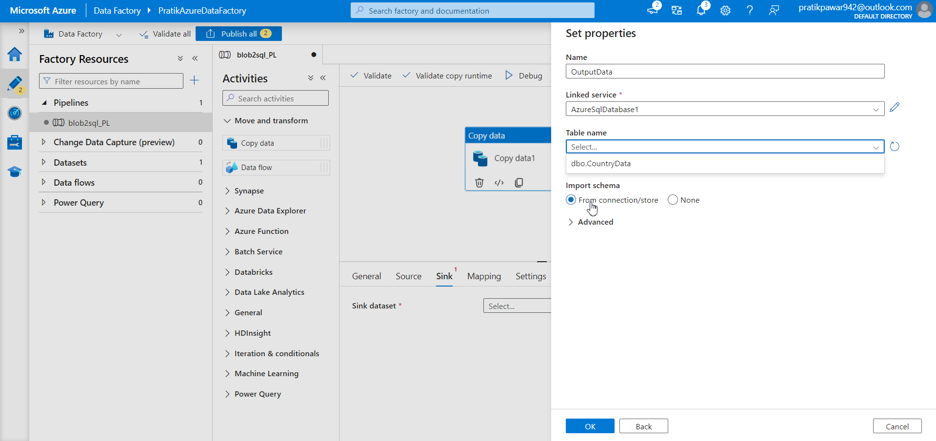
Select from connection store as we are copying new data

Slide 10
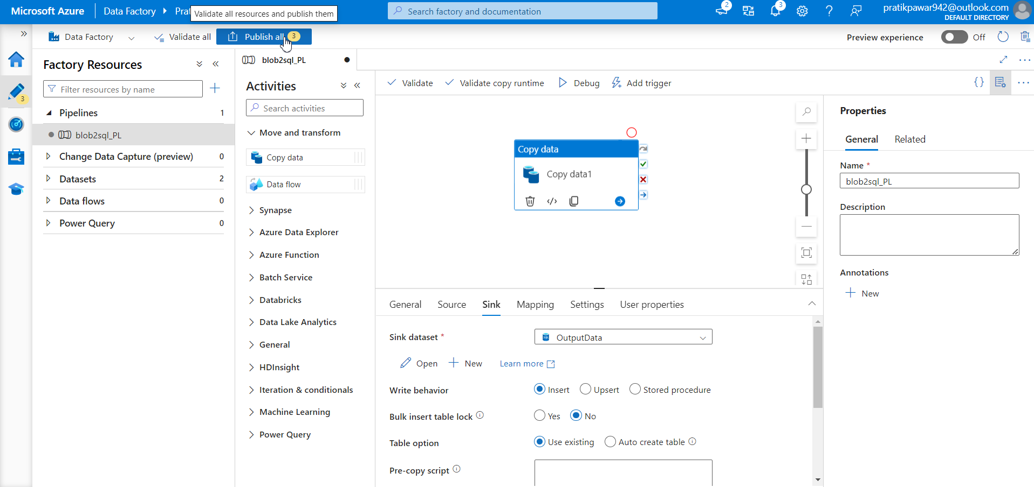
Publish

Slide 11
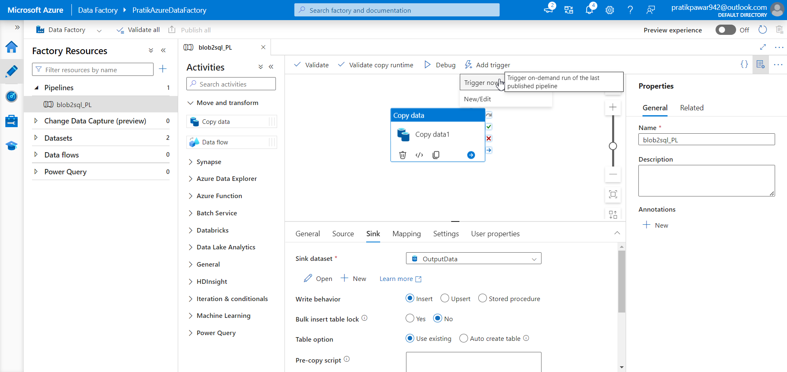
Trigger Now

Slide 12
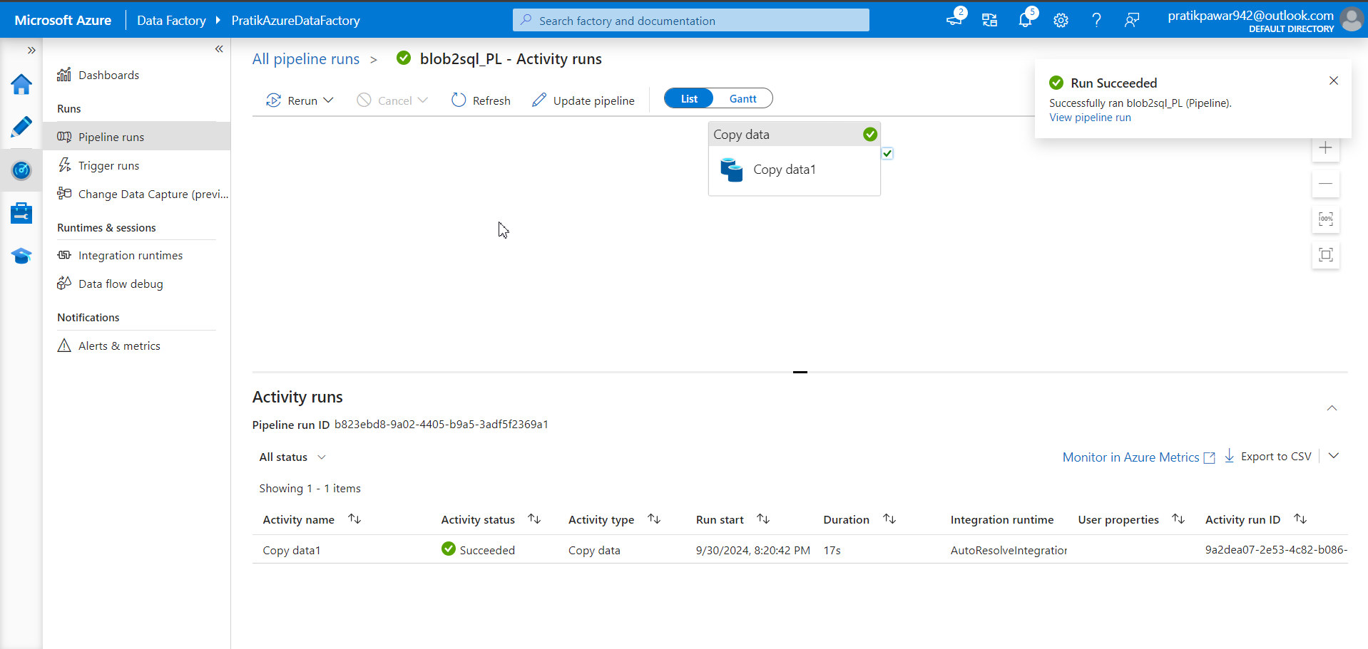
But we want to receive email of success or failure of pipeline to manager or specific person with details

Slide 13
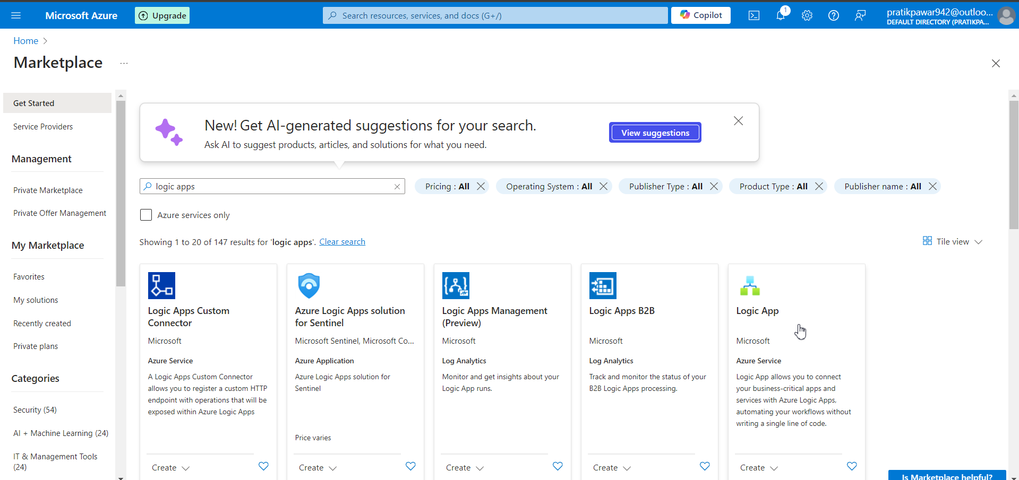
So to get emails of success or failure of pipeline go to logic apps service(its like automation of work)

Slide 14
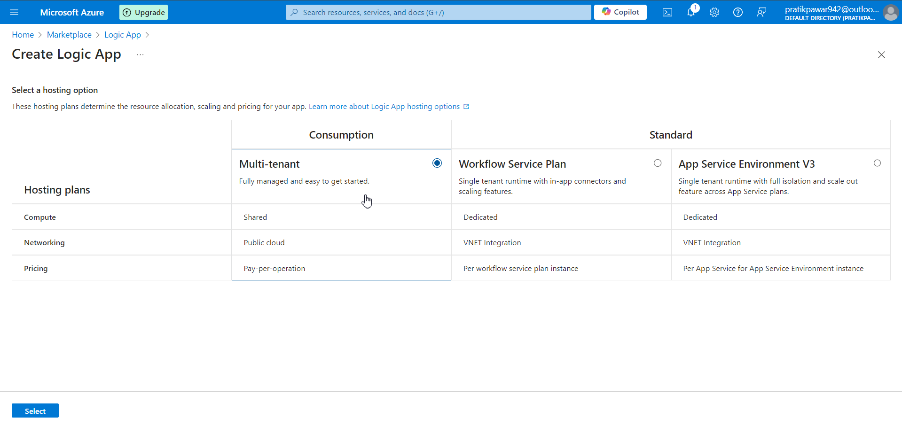
Select hosting option

Slide 15
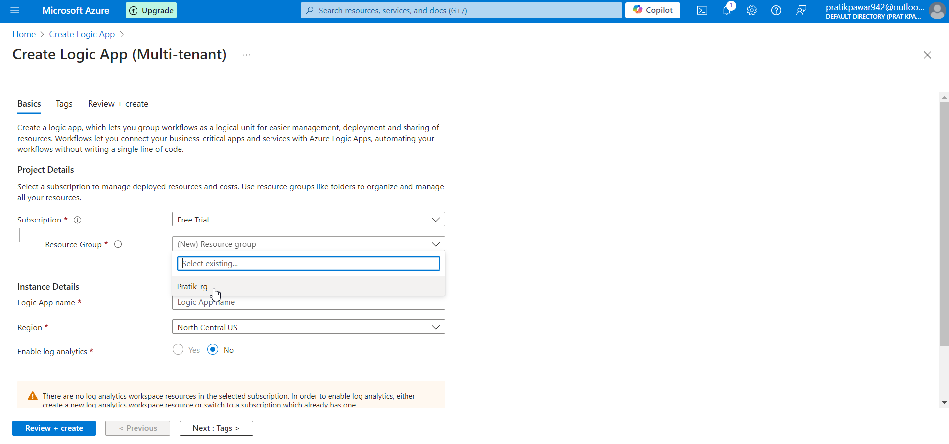
Select Resource Group

Slide 16
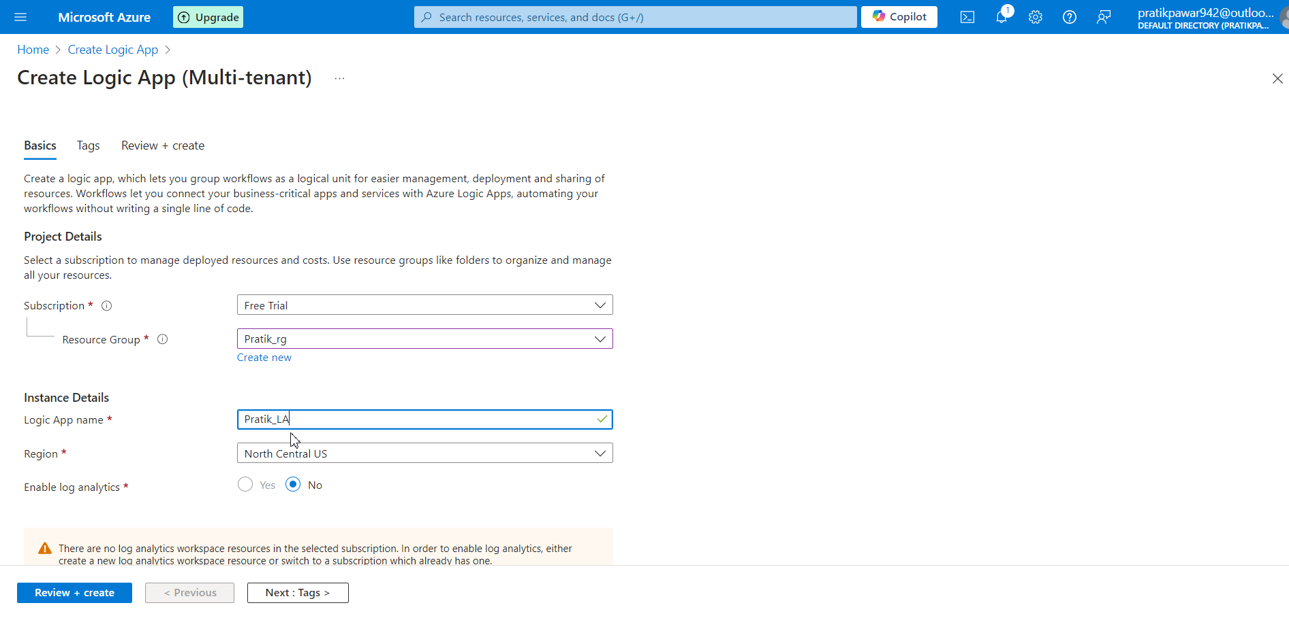
Create logic app name

Slide 17
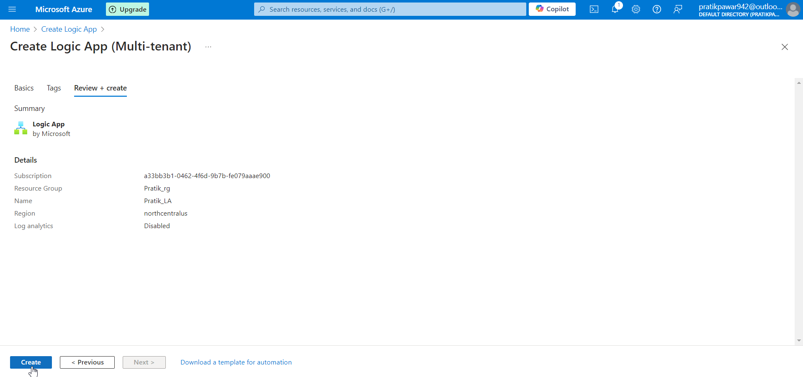
Create(Logic app is service which can attach to any of azure service)

Slide 18
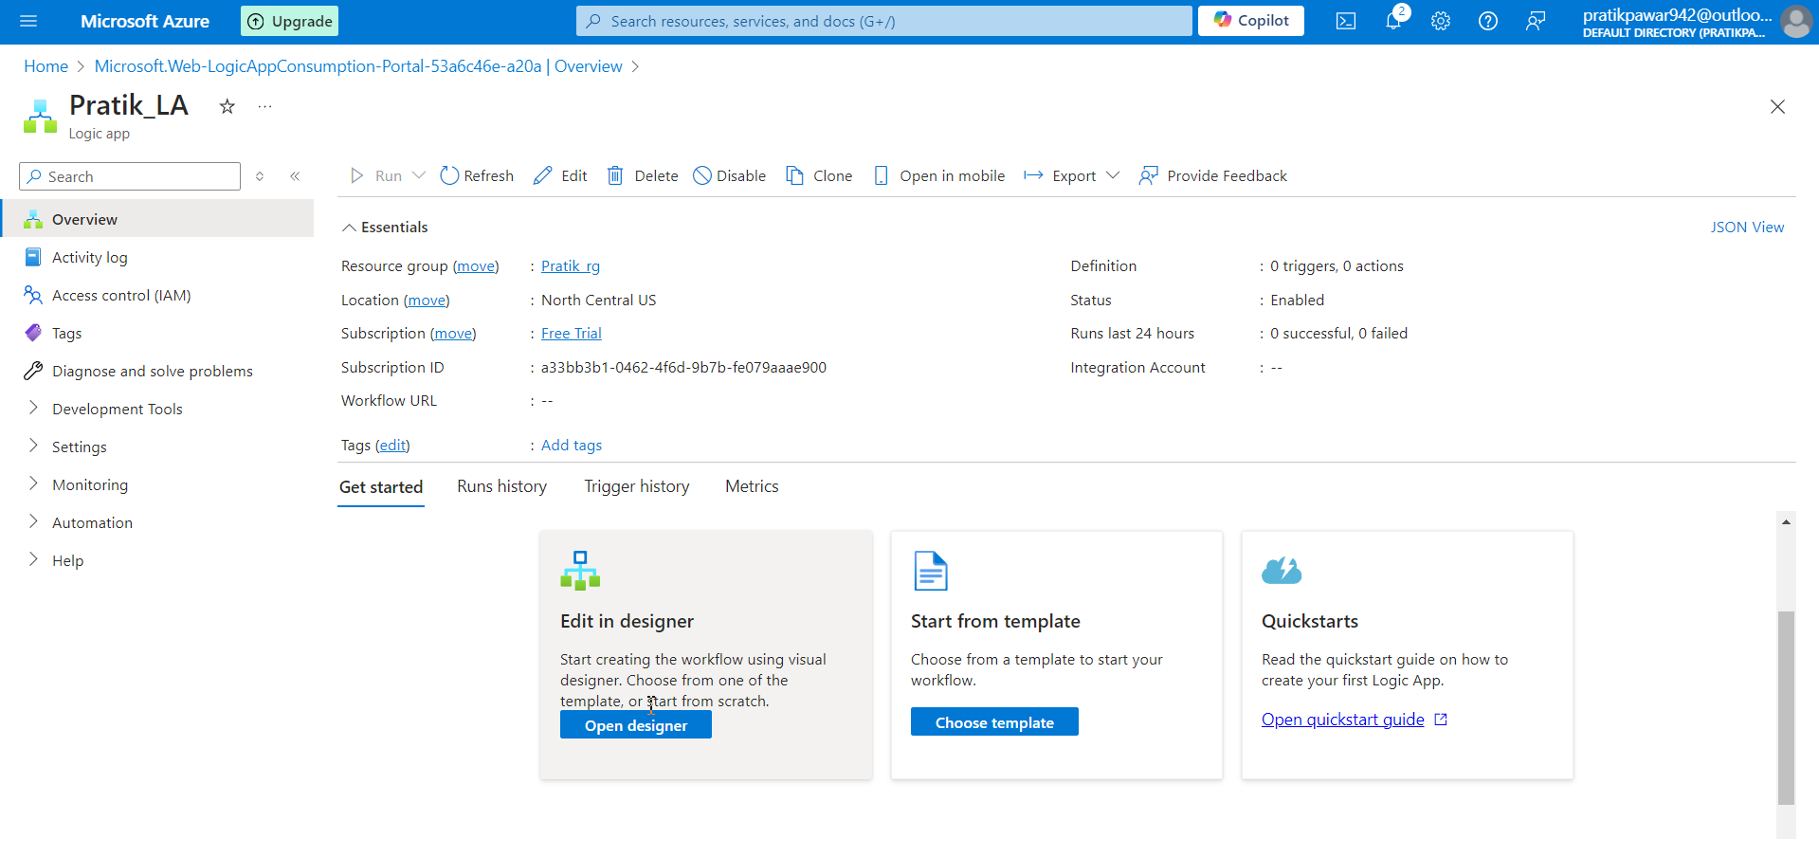
Designer

Slide 19
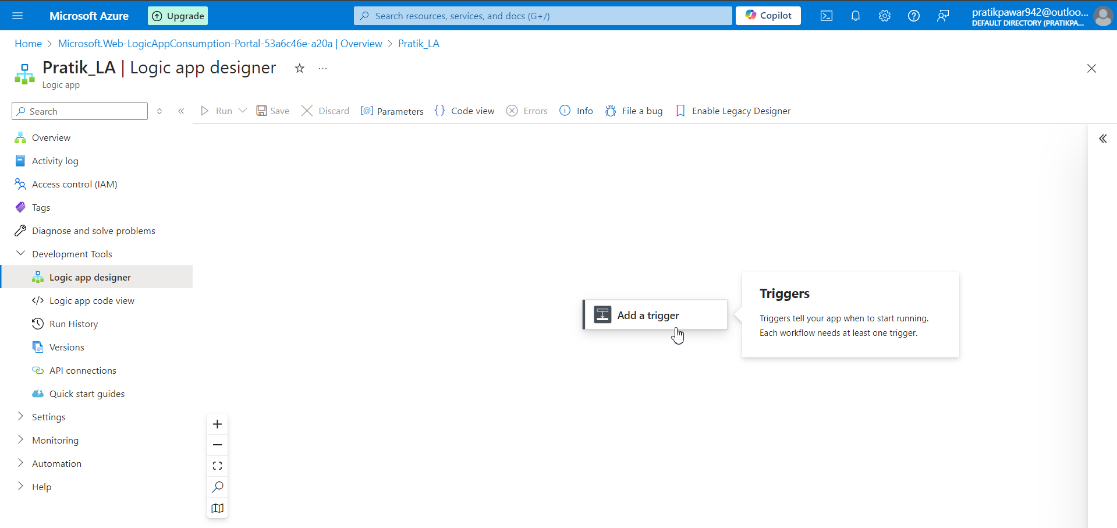
Add a trigger

Slide 20
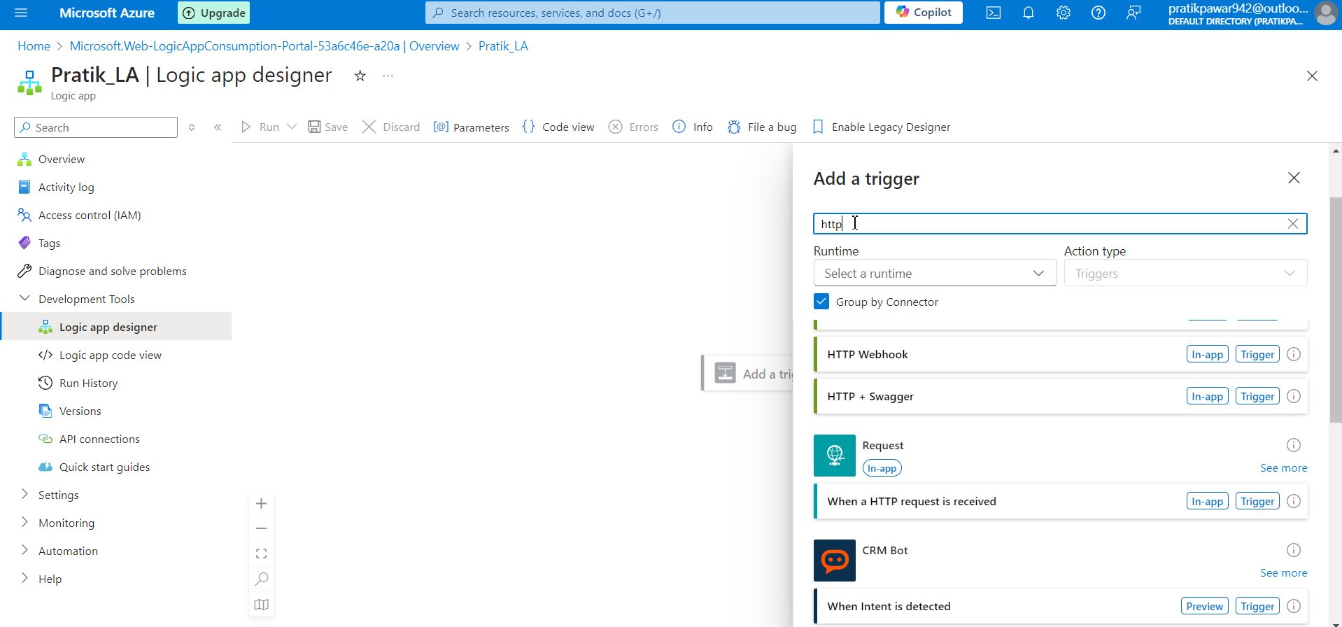
Search http

Slide 21
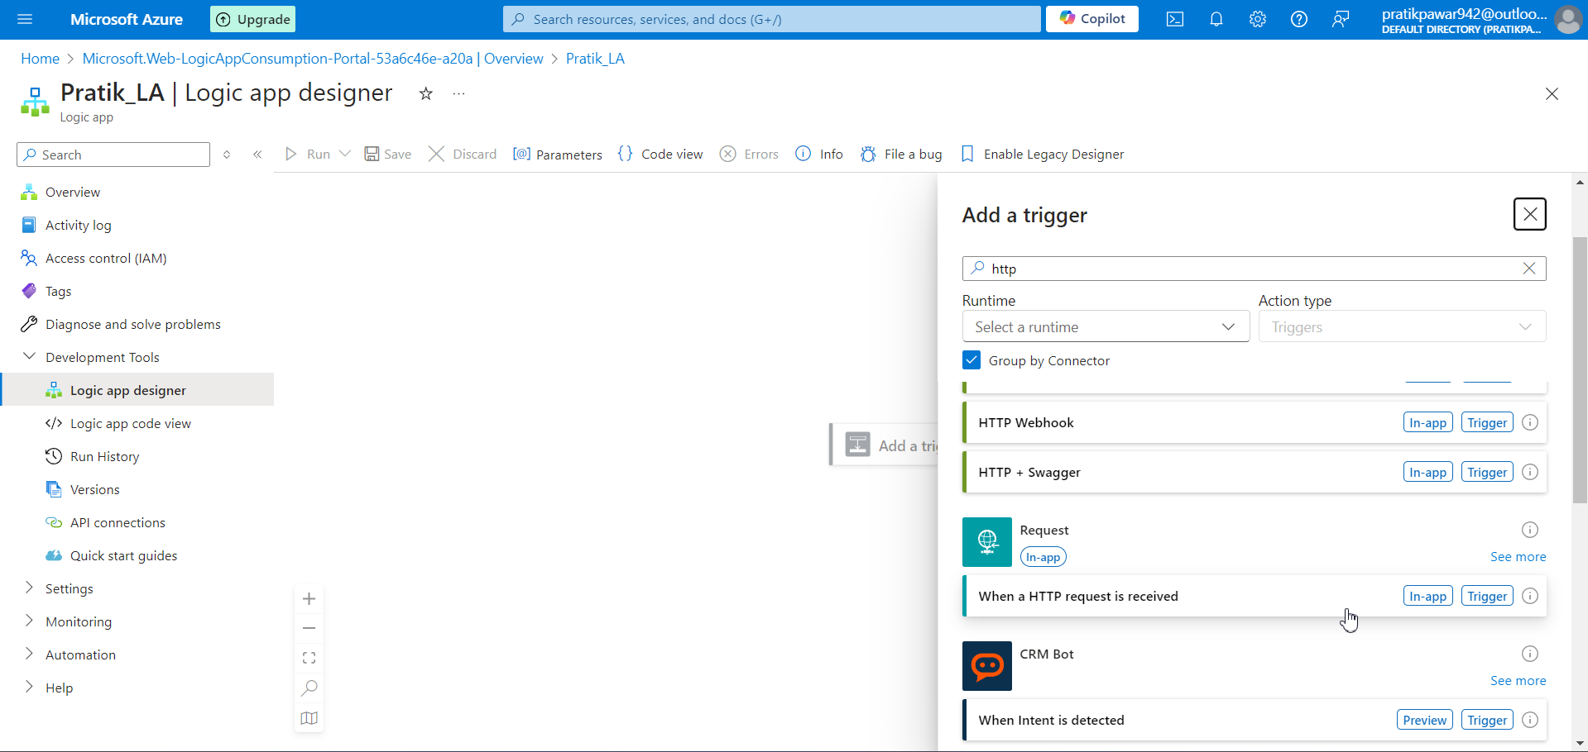
When a http request is received

Slide 22
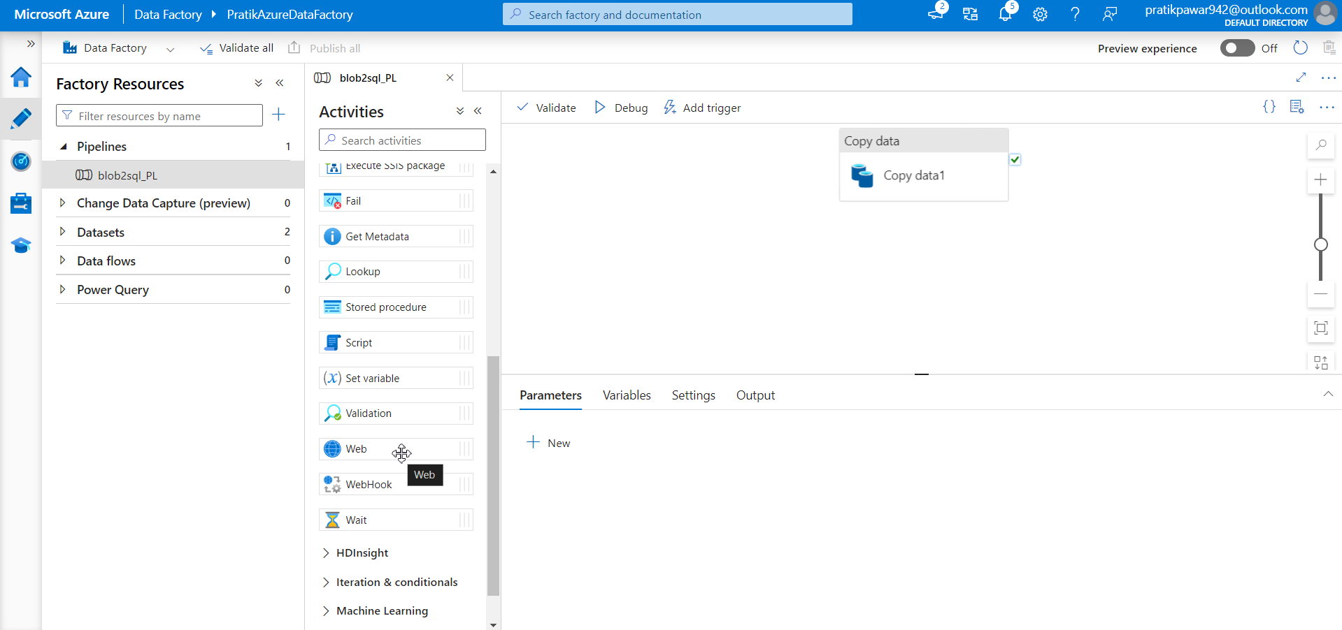
Now go to adf and add activity > general > called web

Slide 23
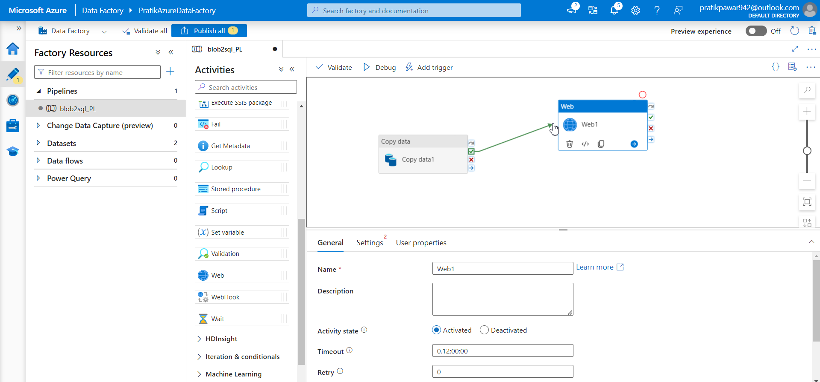
Now connect on success to web

Slide 24
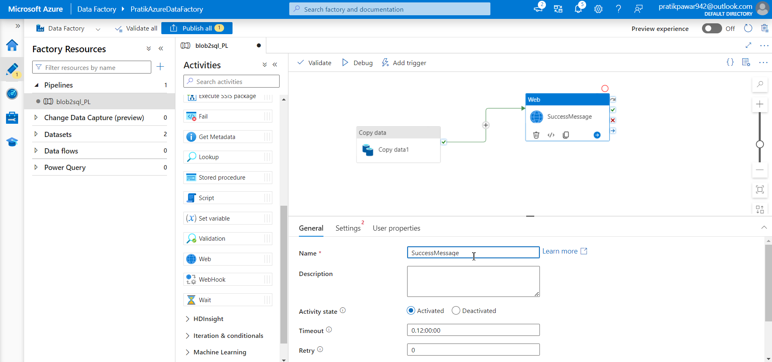
Rename this as successmessage

Slide 25
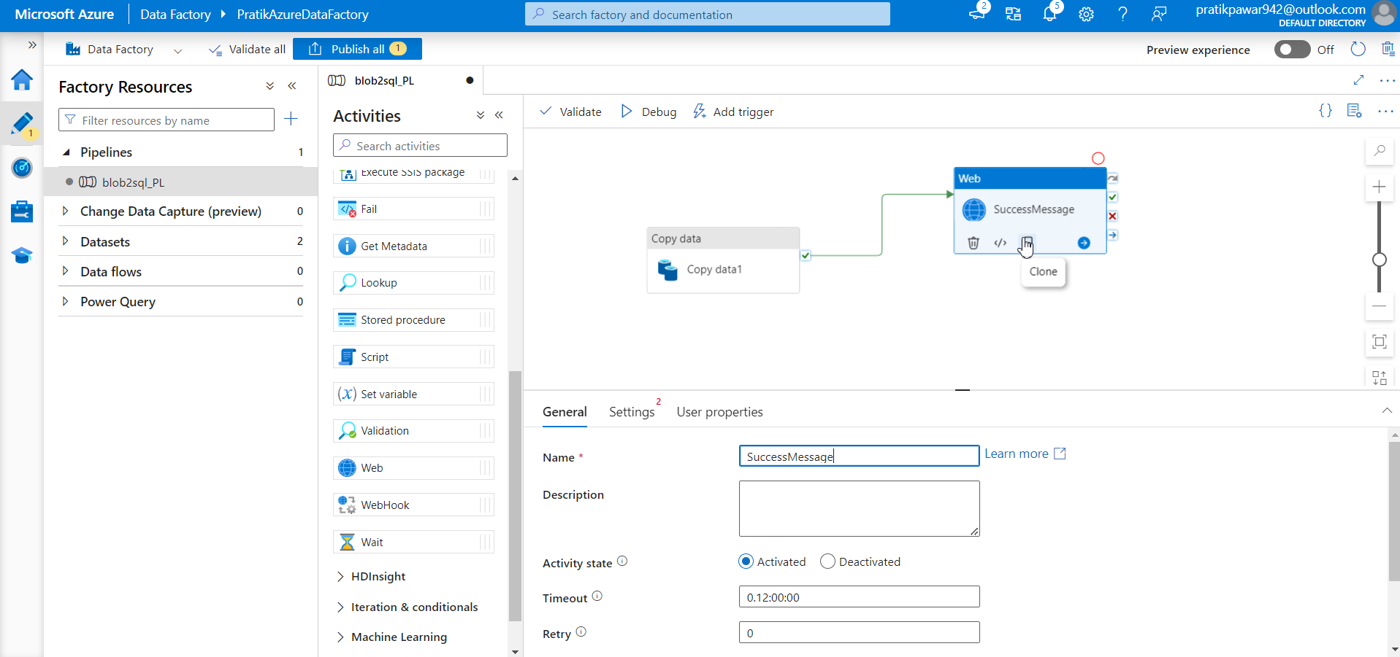
Now whenever the pipeline success, it will enable the web activity which will send http request and it is captured by Logic apps. So when ever the request comes in Logic apps, it send email

Slide 26
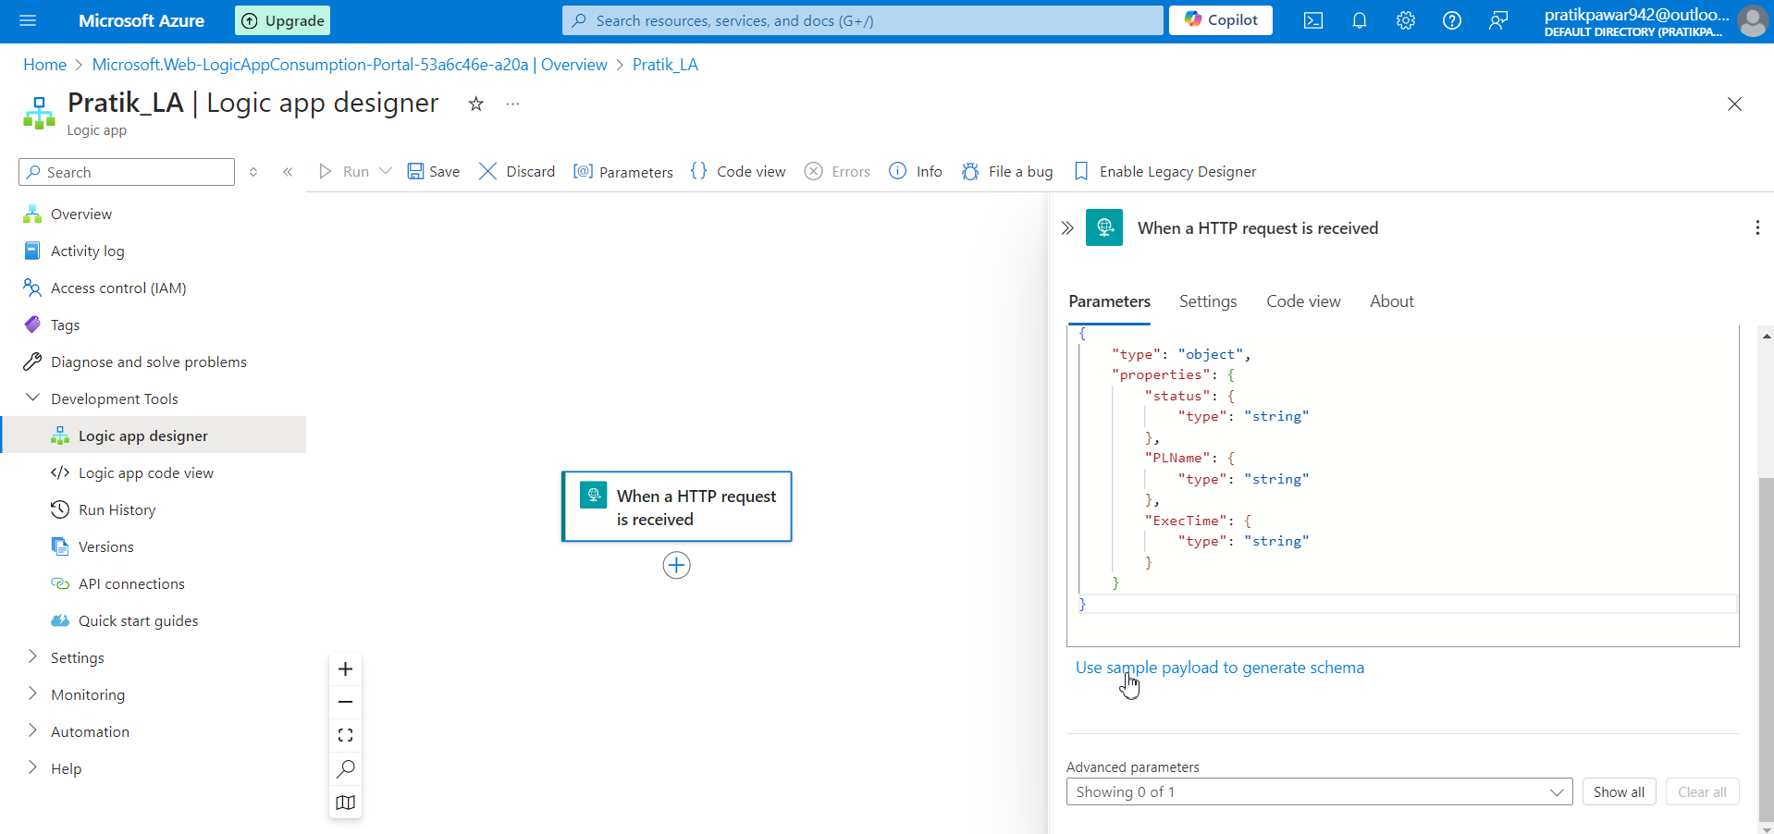
GO to sample payload

Slide 27
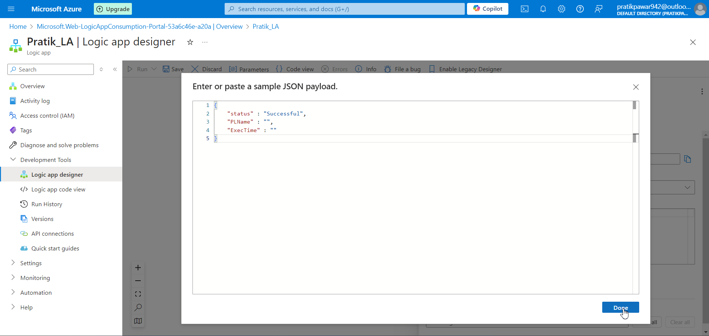
Write this and select done

Slide 28
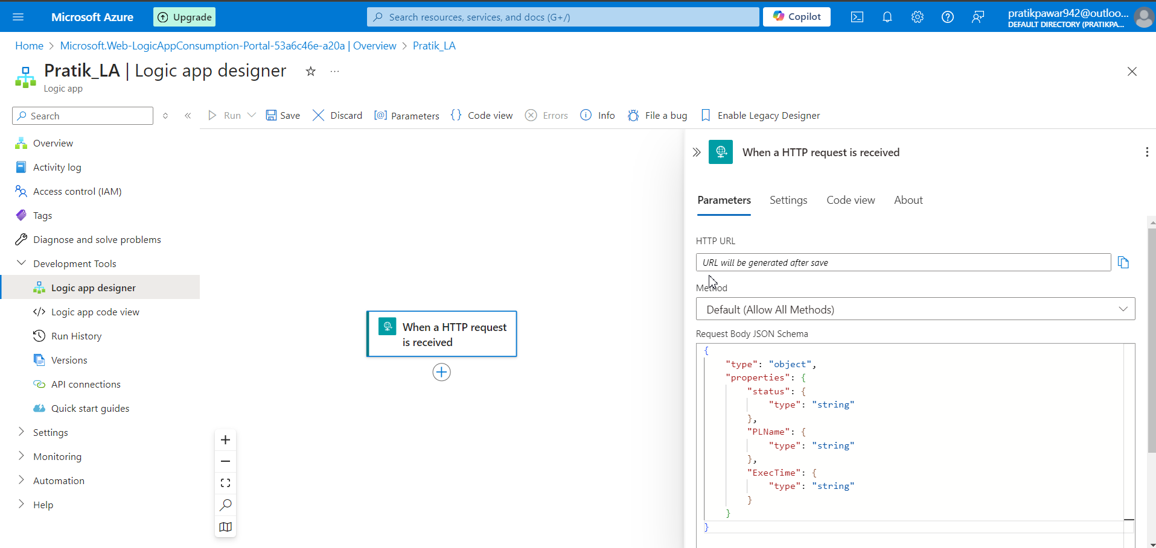
Now to connect with ADF we need this url which is generated by saving and reopening trigger

Slide 29
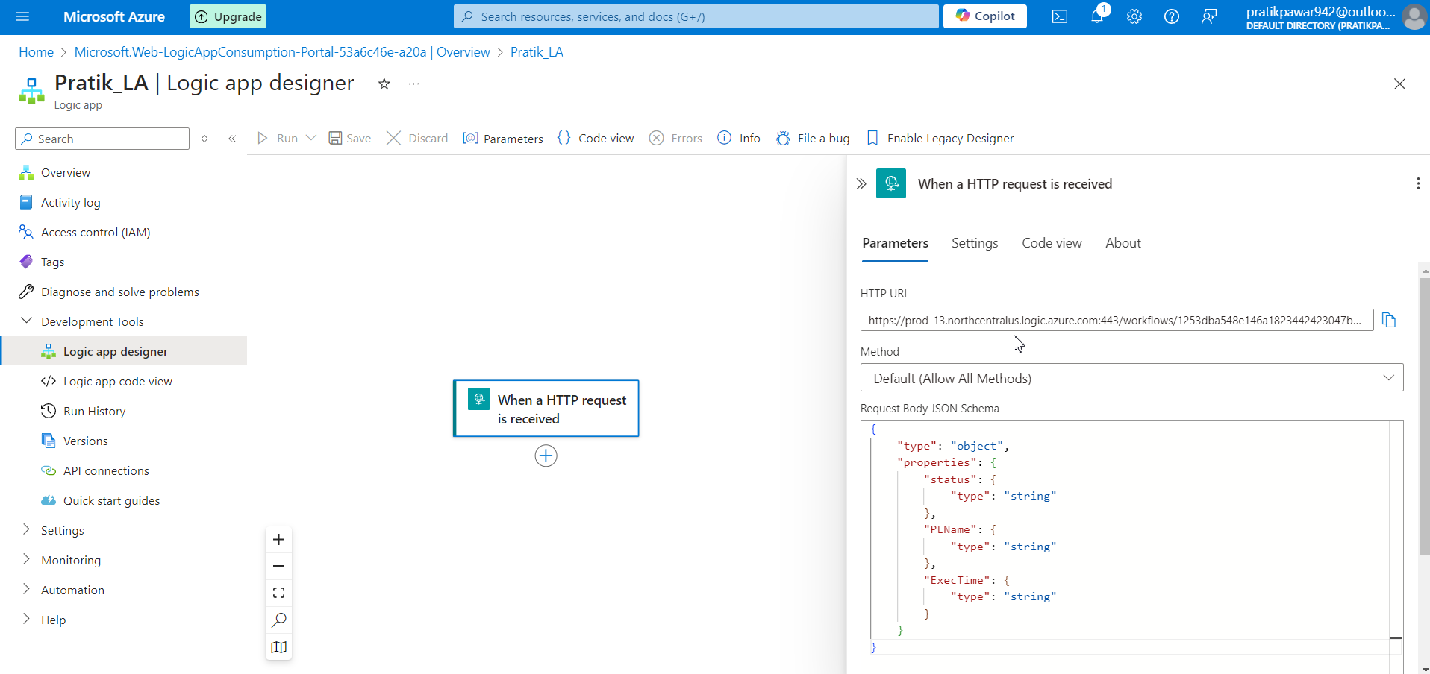
Url is generated

Slide 30
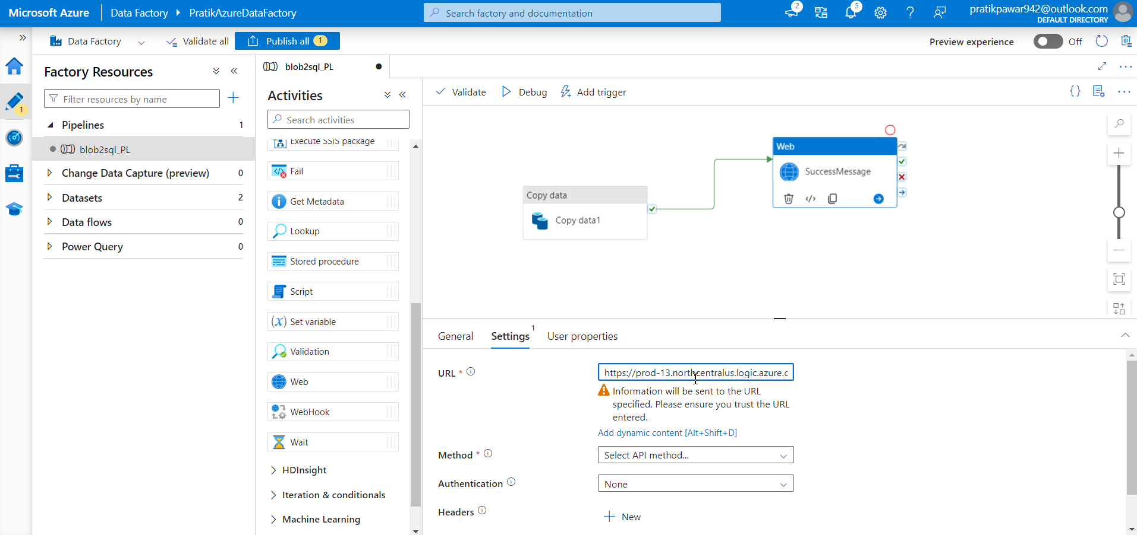
Now paste that URL in ADF > WEB>Setting>URL

Slide 31
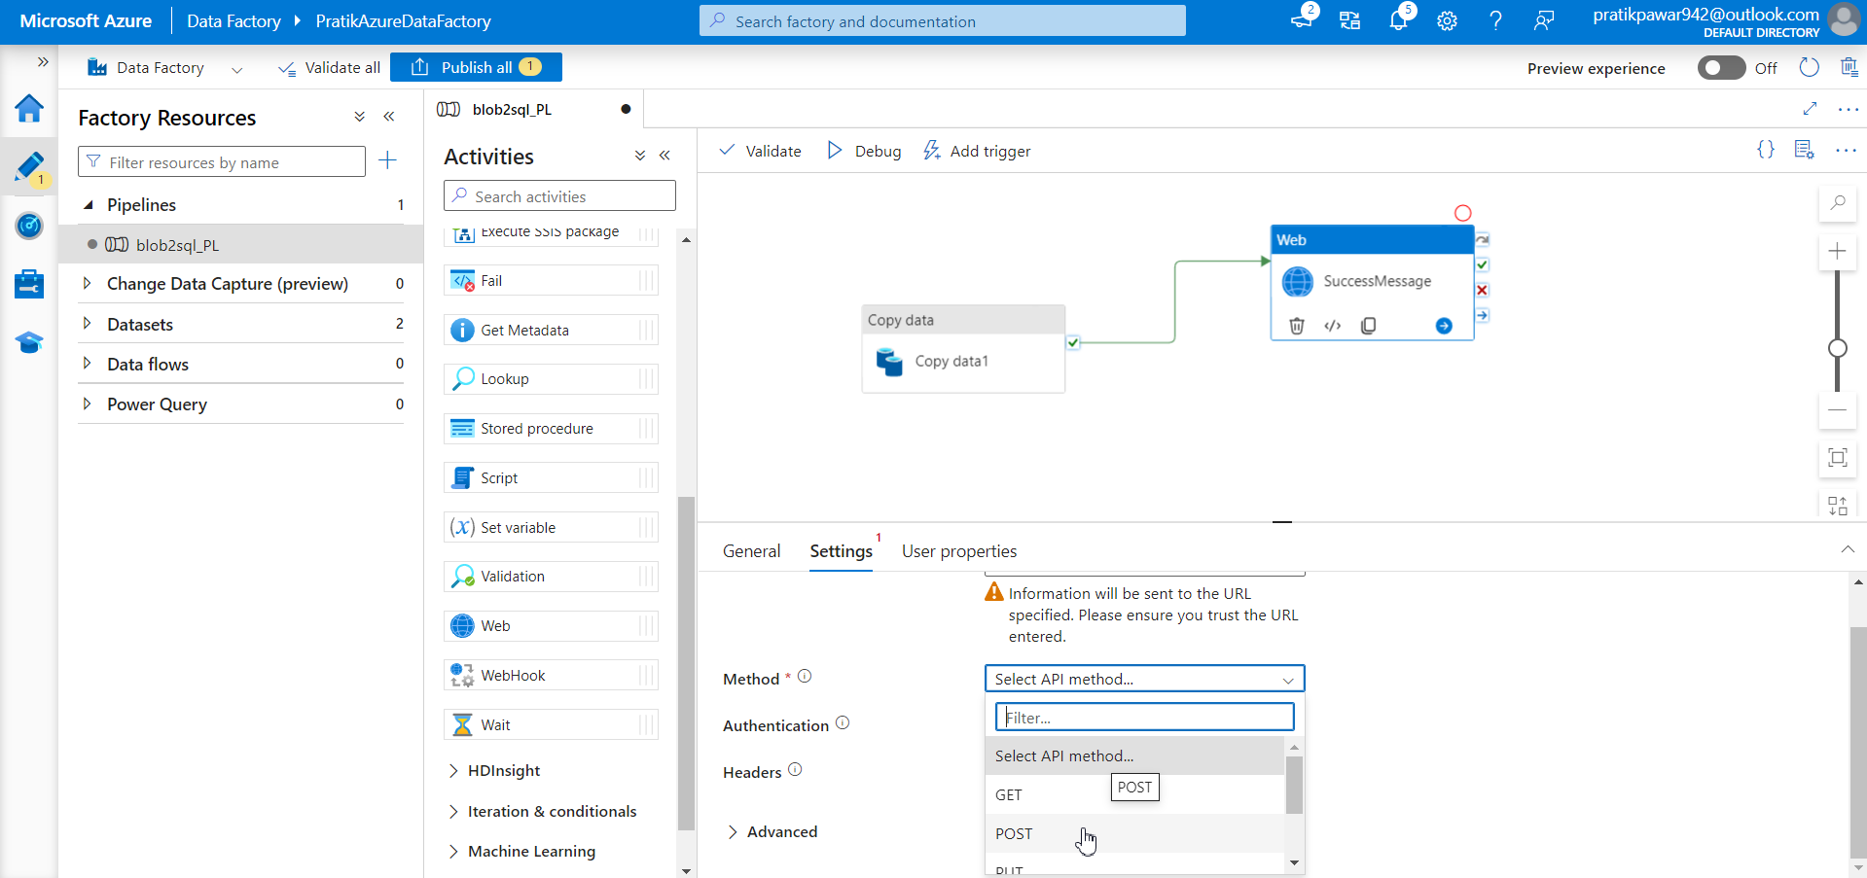
Select method as post as we are sending request to URL

Slide 32
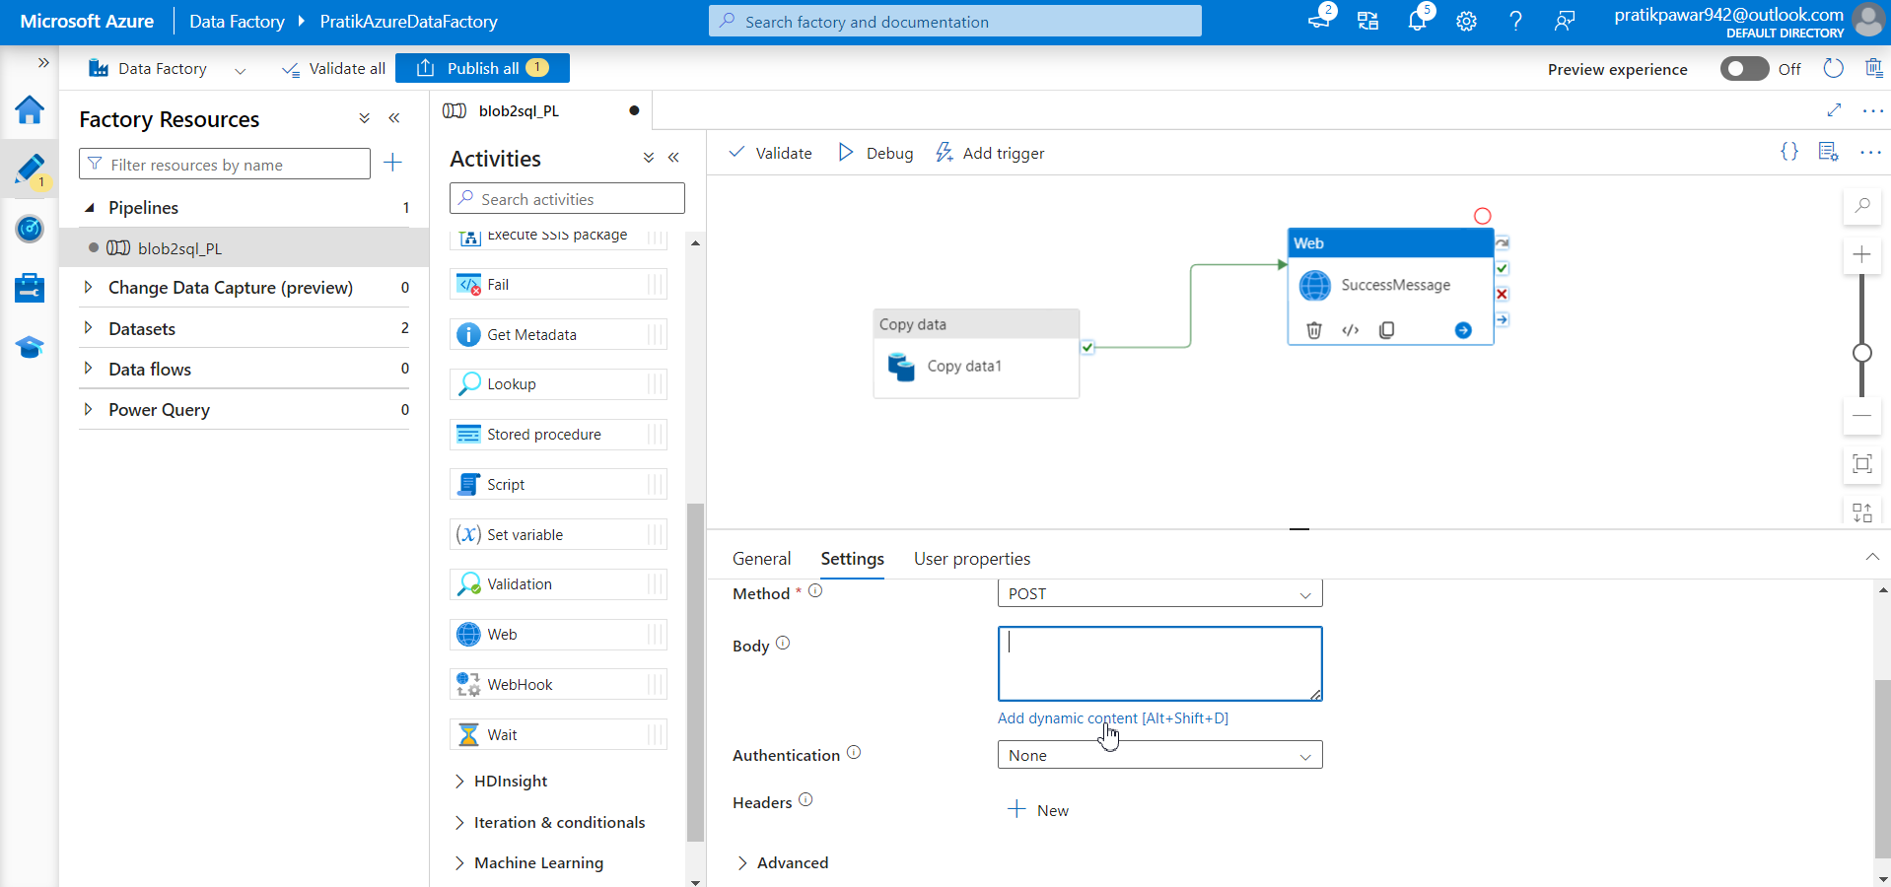
Now Body>add Dynamic Content ( in body what are request or things you are going to send)

Slide 33
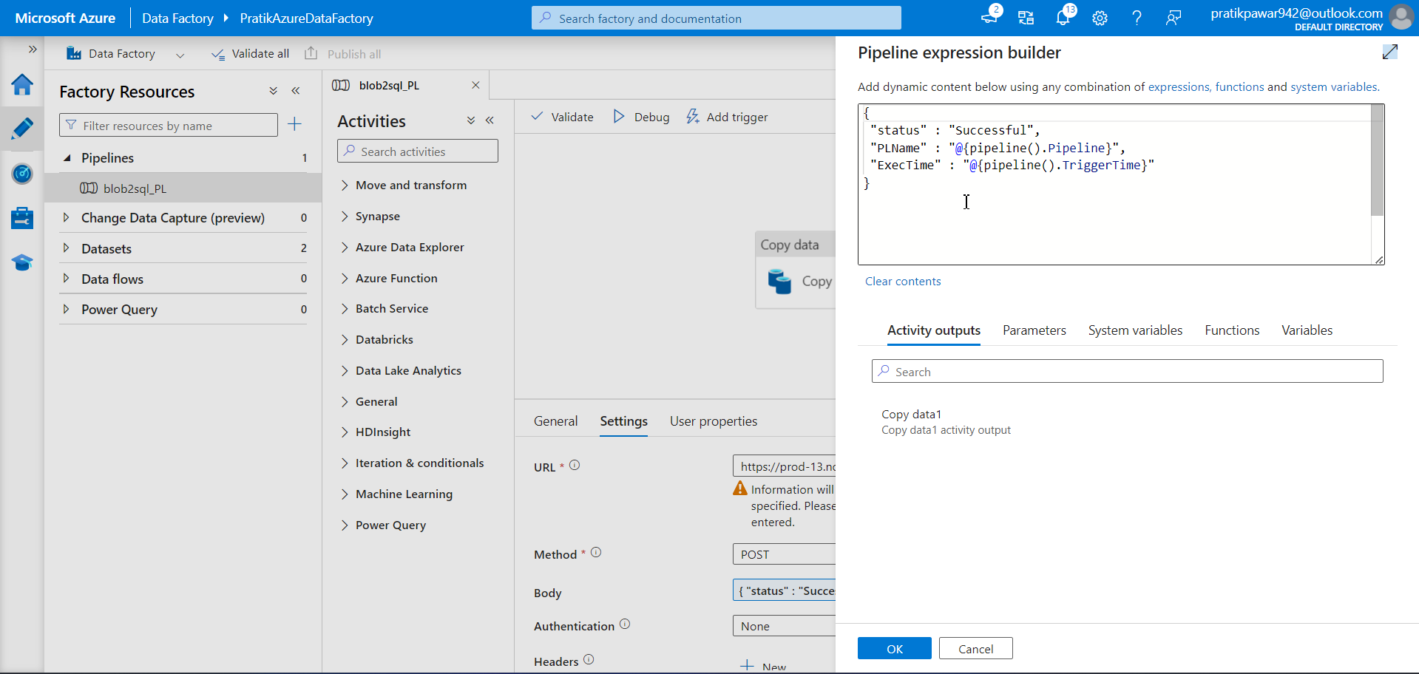
Write this in body

Slide 34
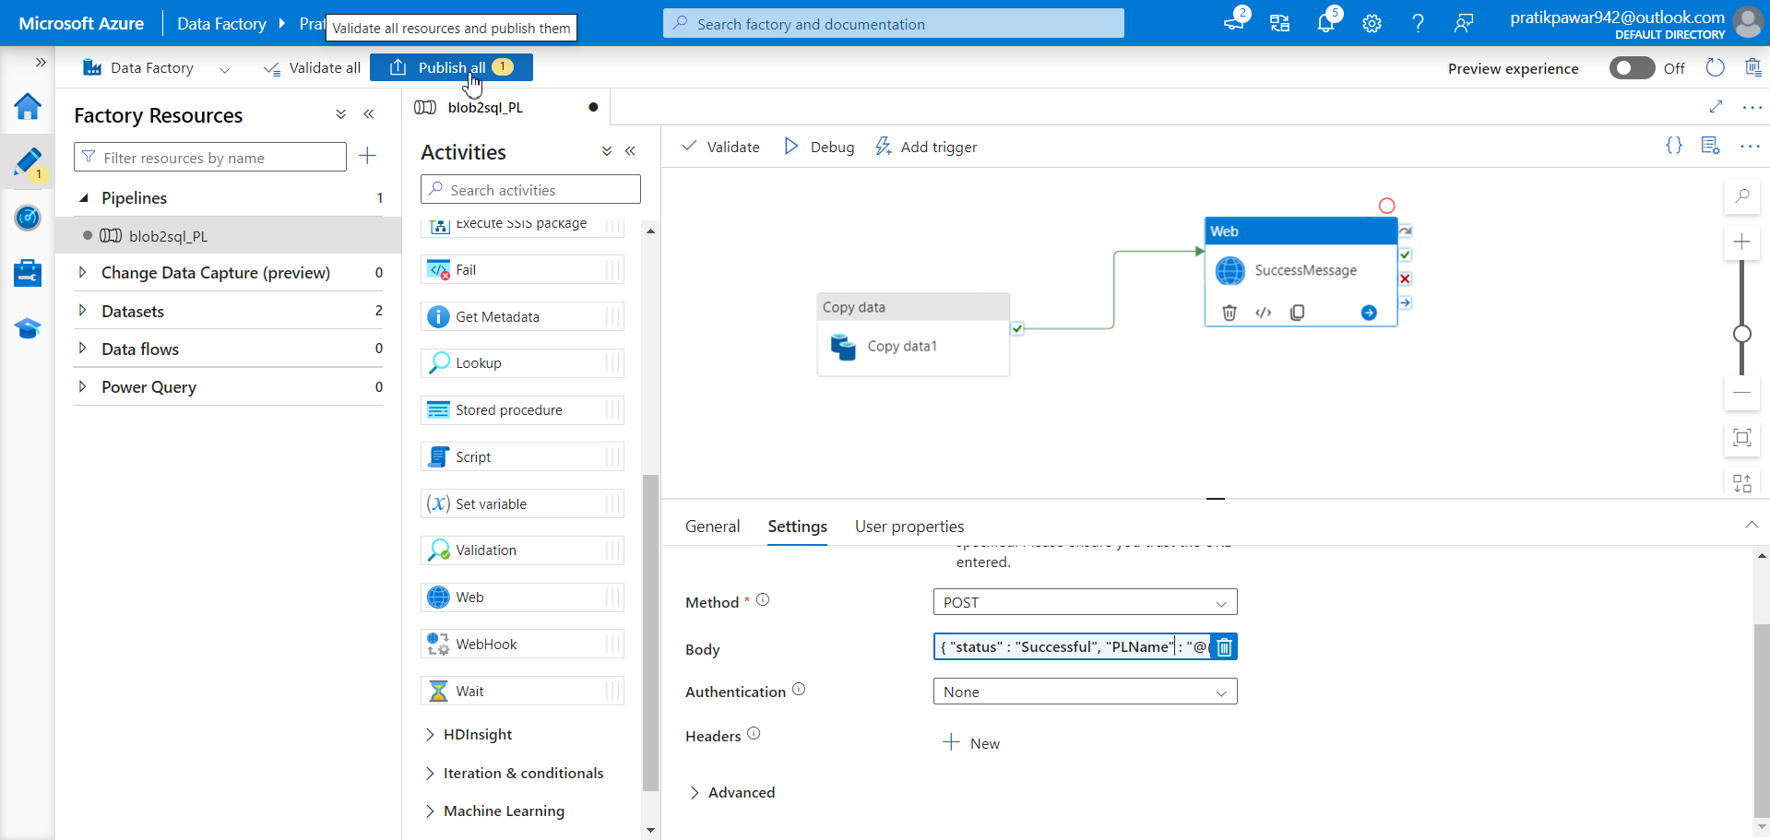
Publish

Slide 35
Now copy this

Slide 36
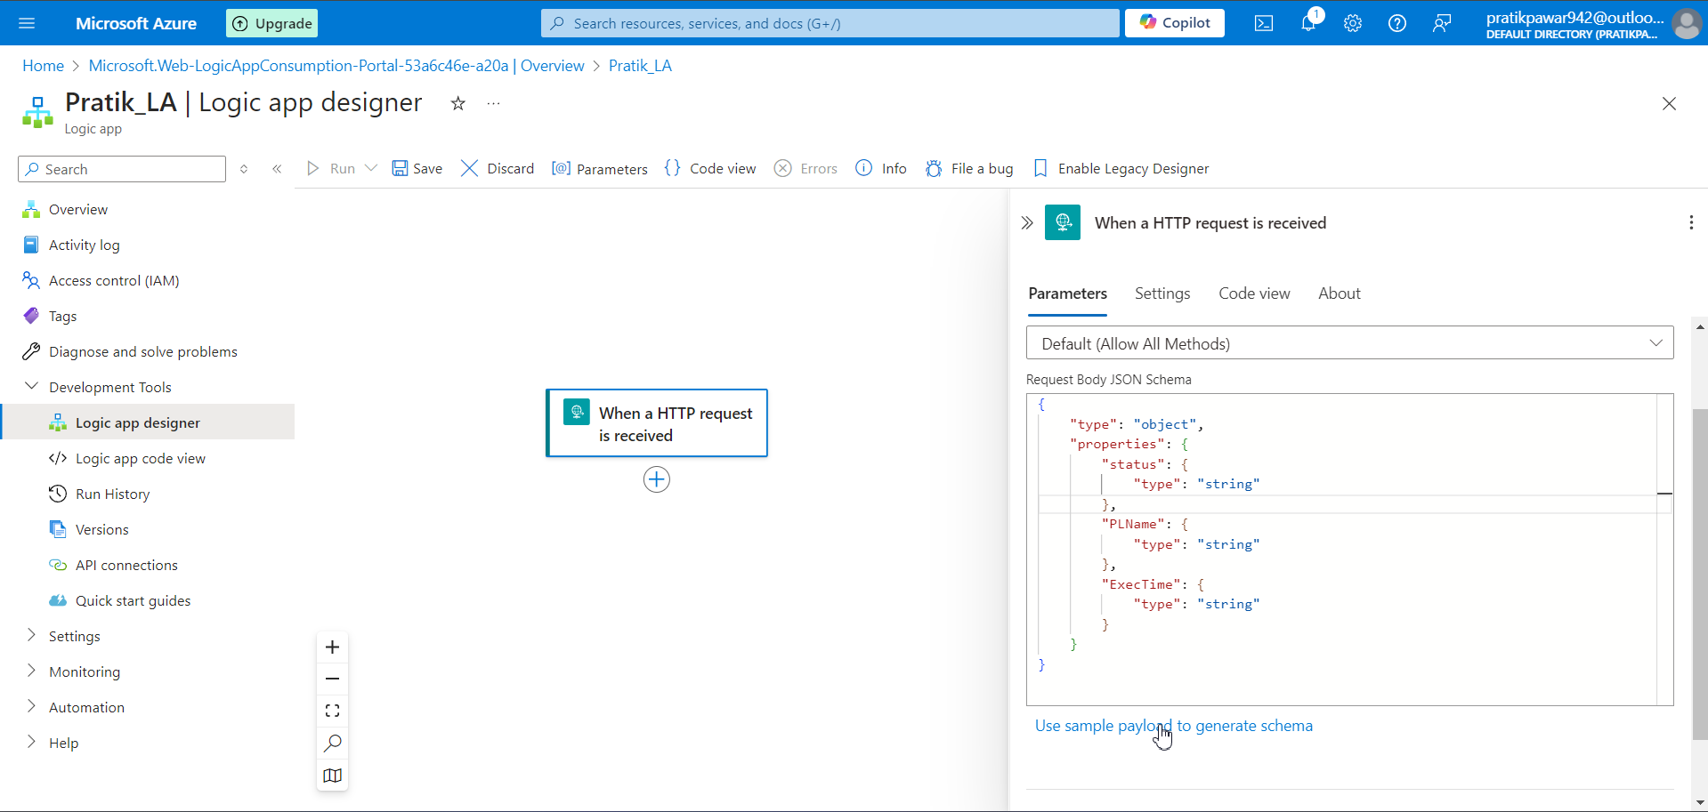
Go to sample payload and paste it here

Slide 37
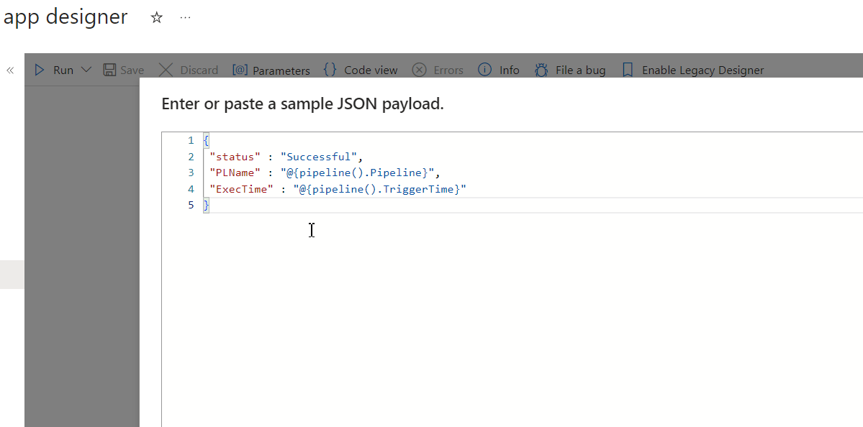
Done

Slide 38
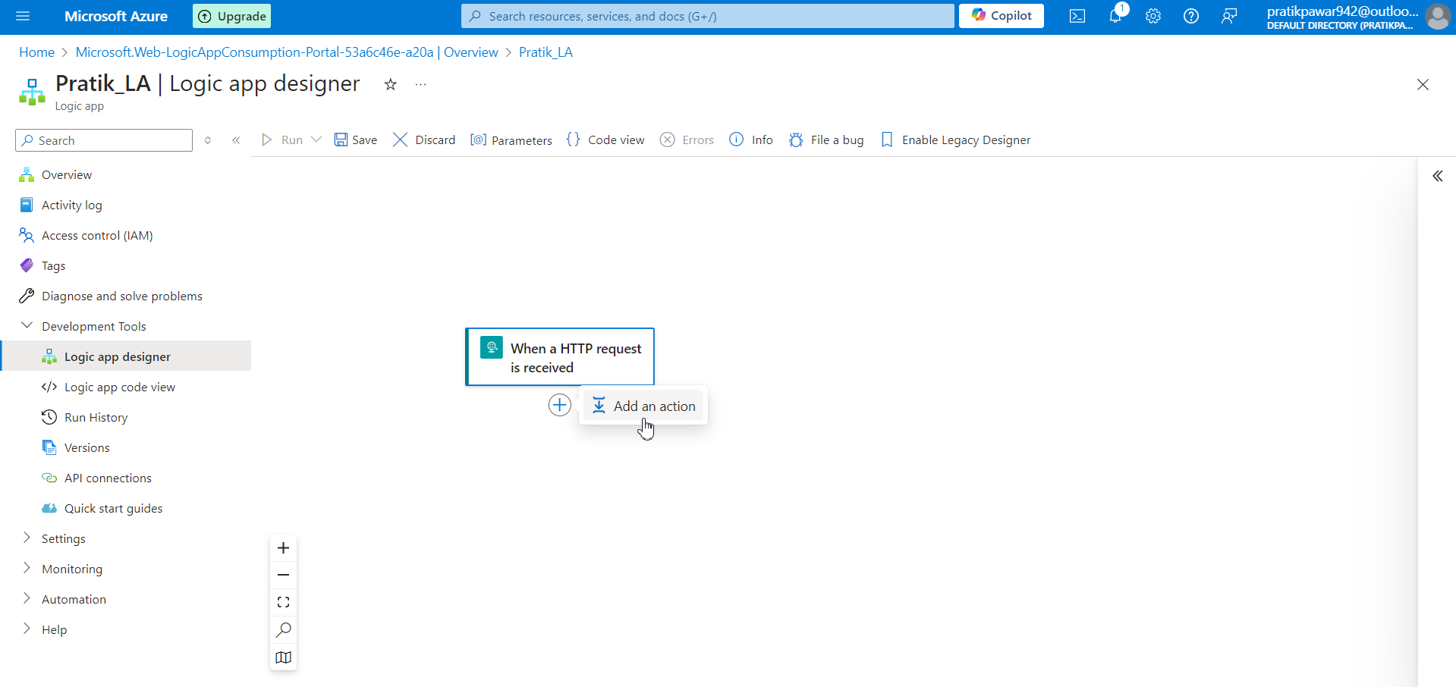
Add Action

Slide 39
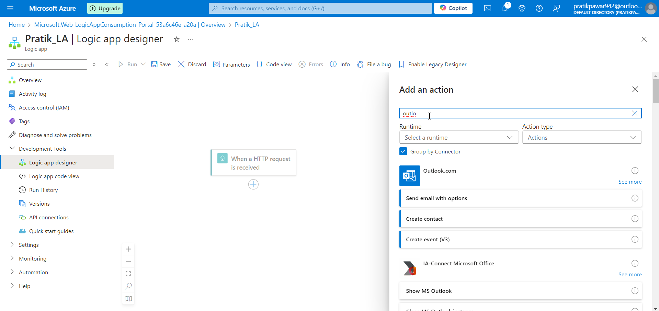
Search outlook

Slide 40
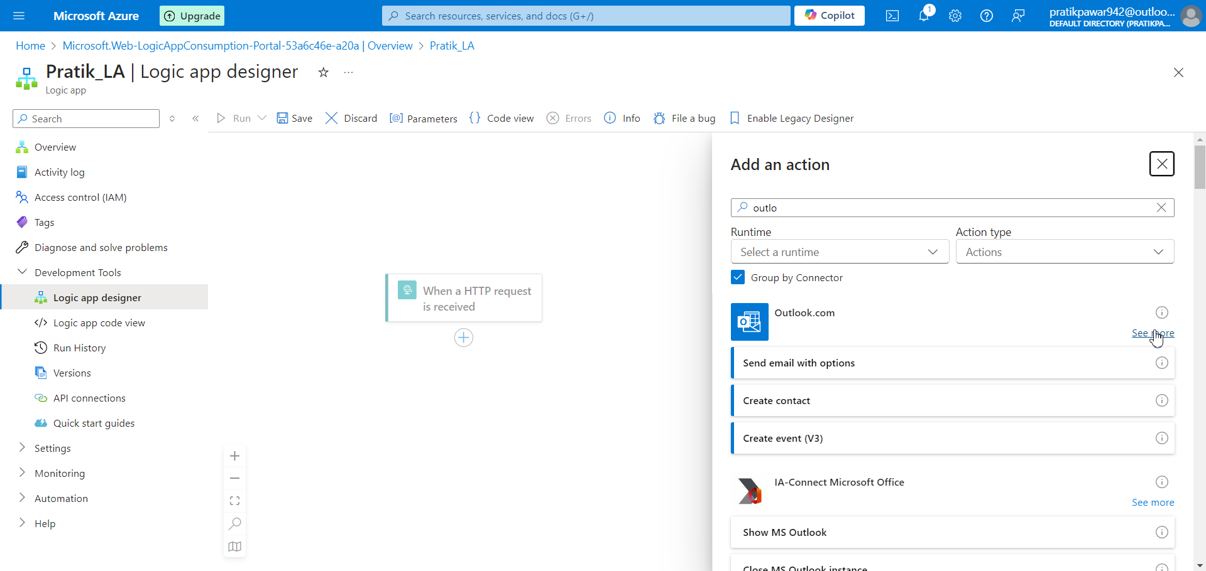
See More

Slide 41
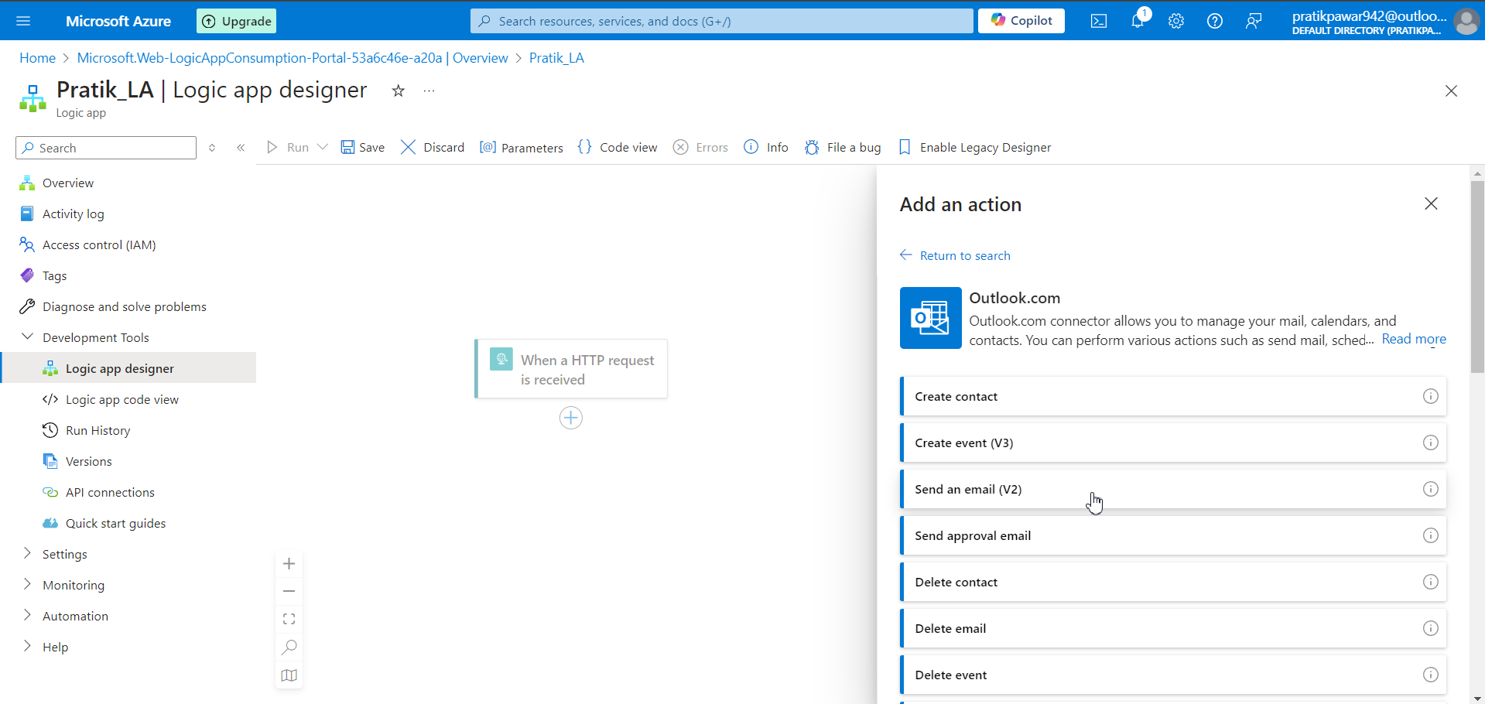
Send email V2

Slide 42
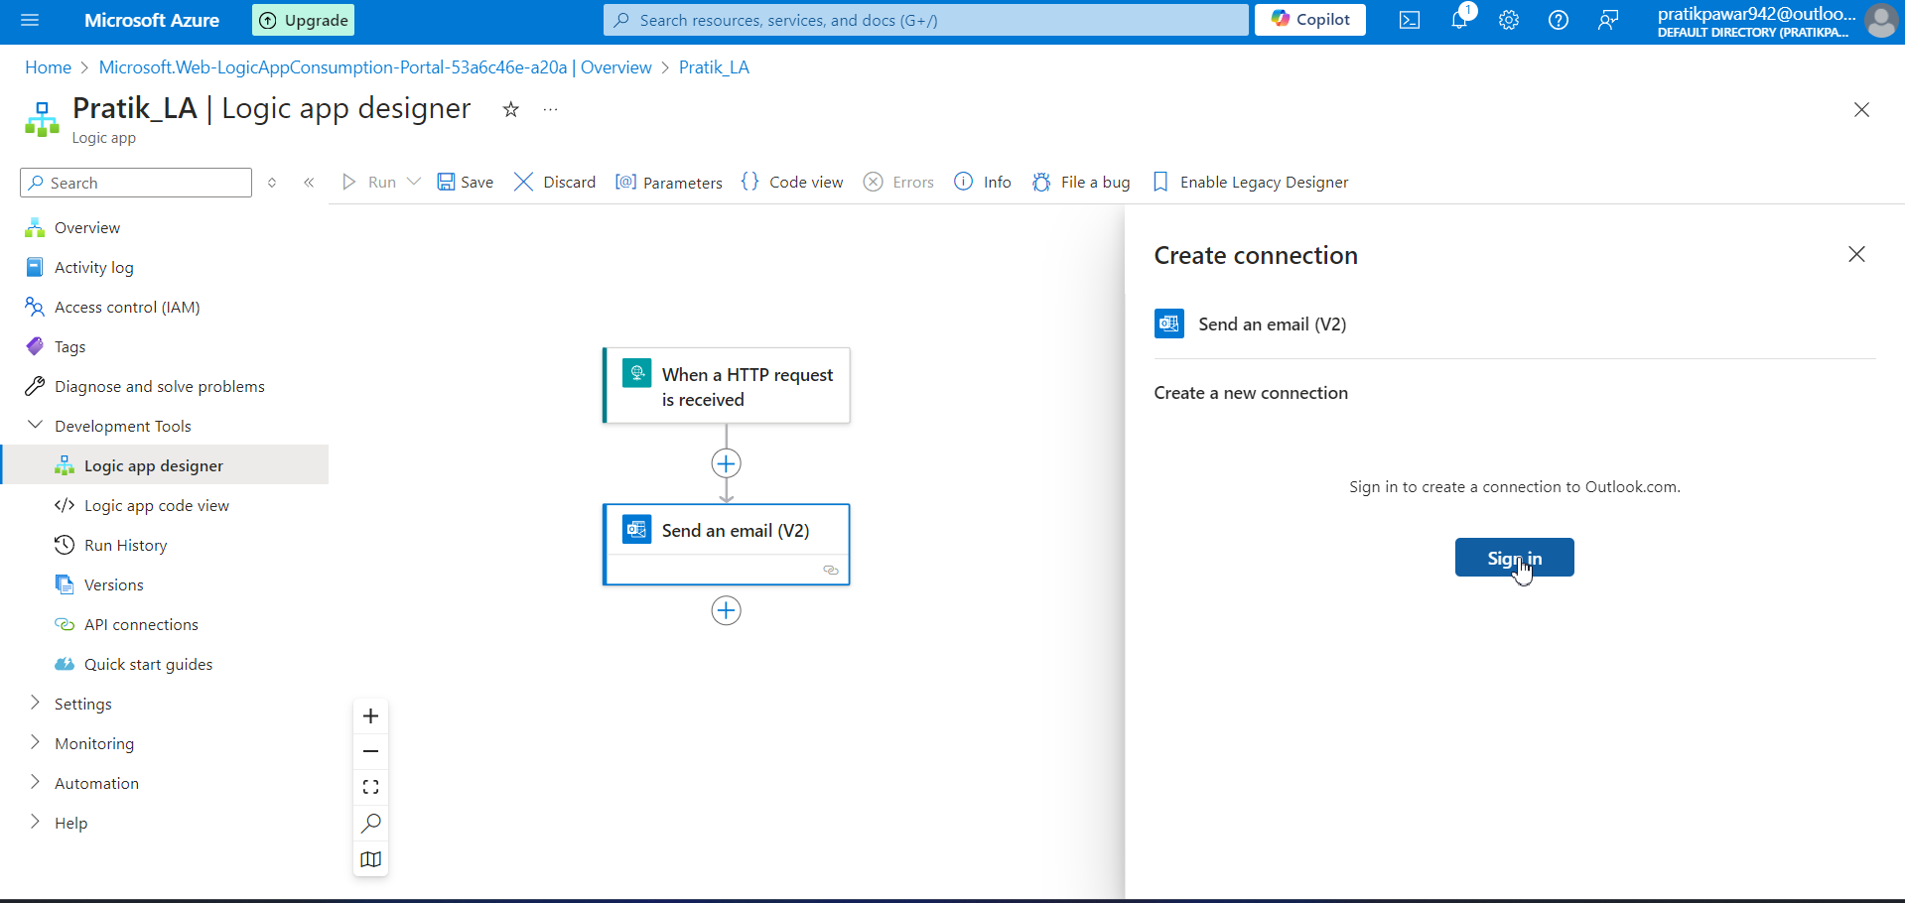
Sign in

Slide 43
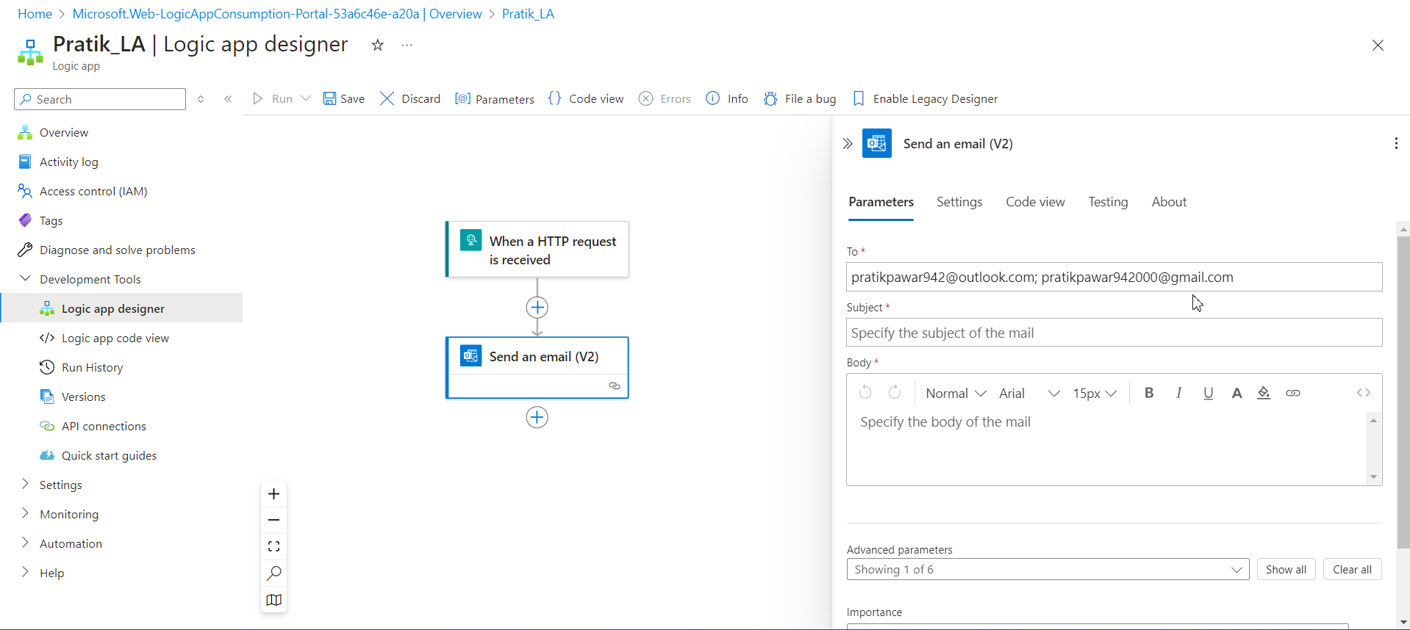
Add emails here to whom you want to send

Slide 44
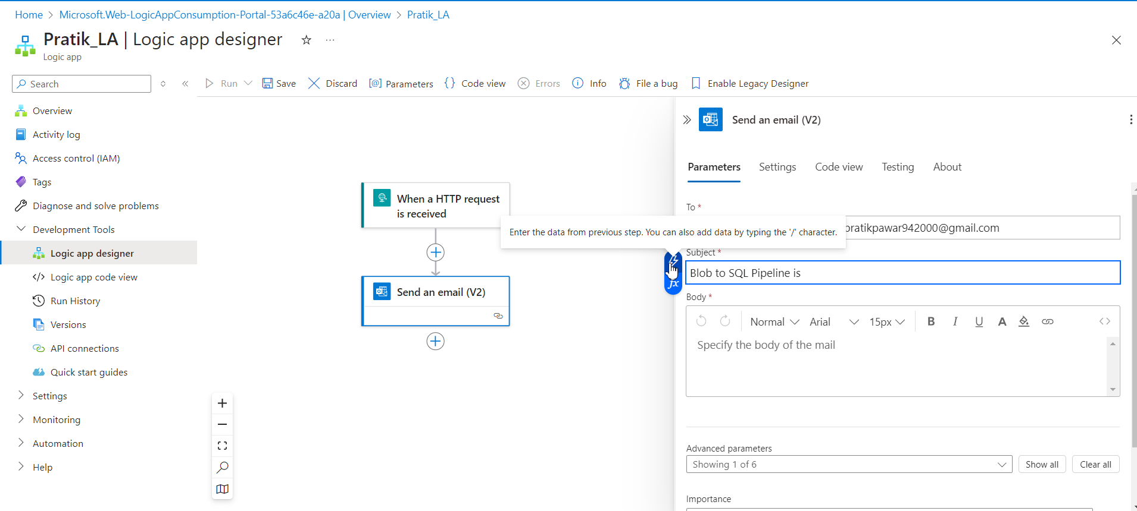
Write ‘Blob to SQL Pipeline is ’ instead of writing successful go to trigger option

Slide 45
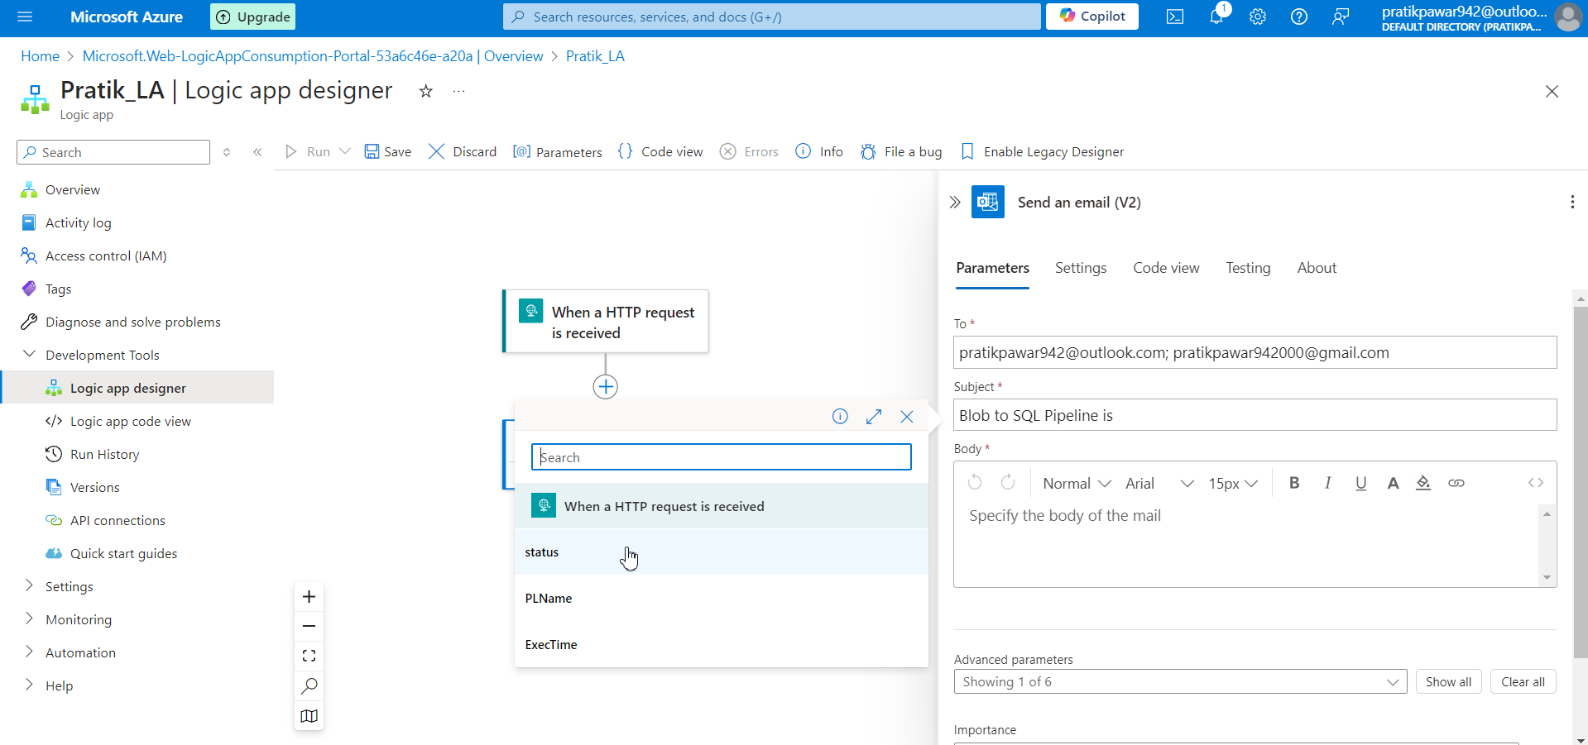
Select Status as status output is successful

Slide 46
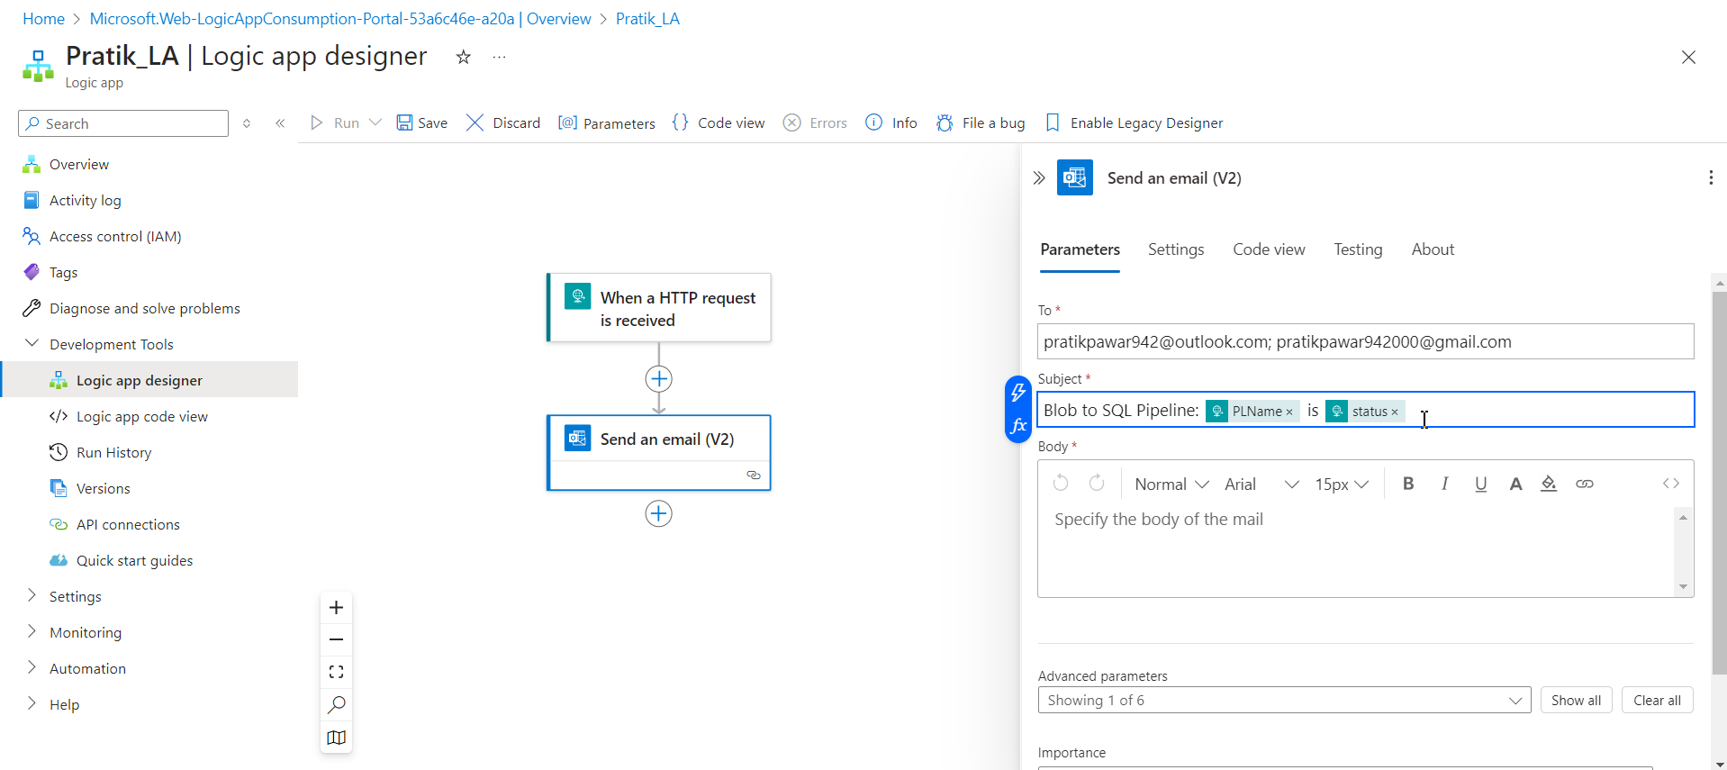
This is better

Slide 47
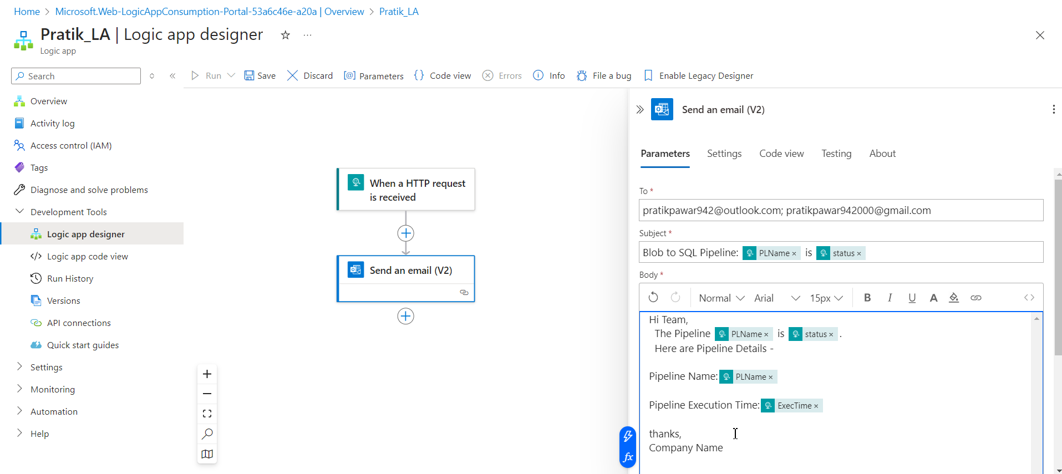
Write this in Body ie email body

Slide 48
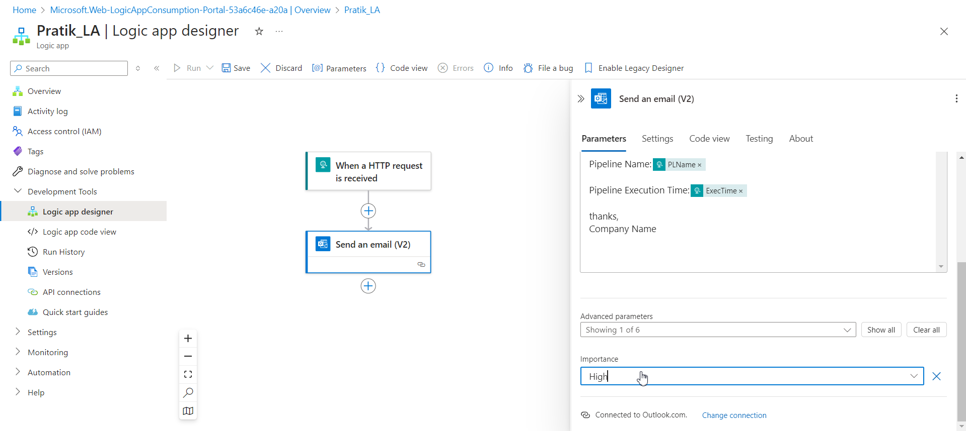
Importance : High

Slide 49
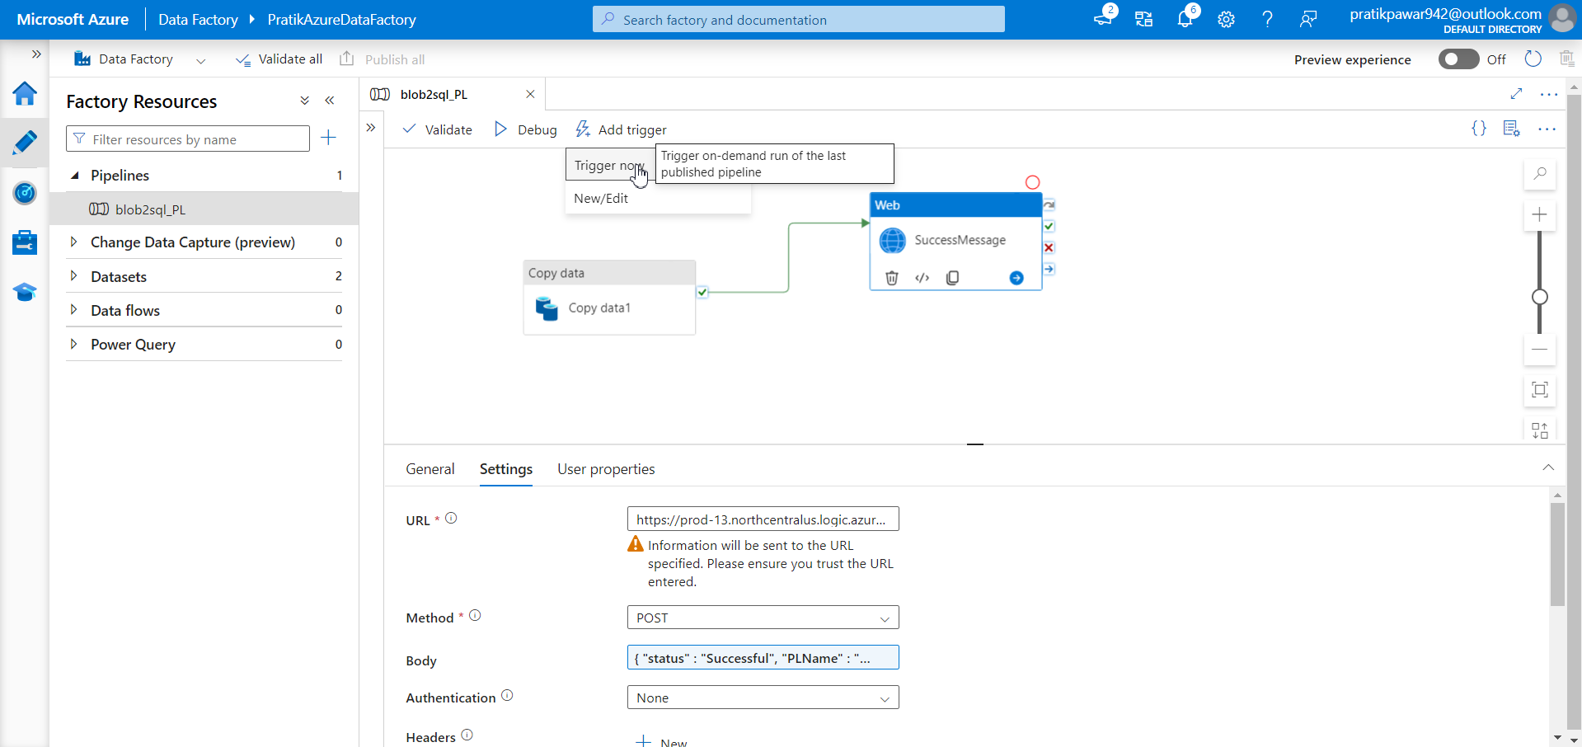
Now Run the Pipeline

Slide 50
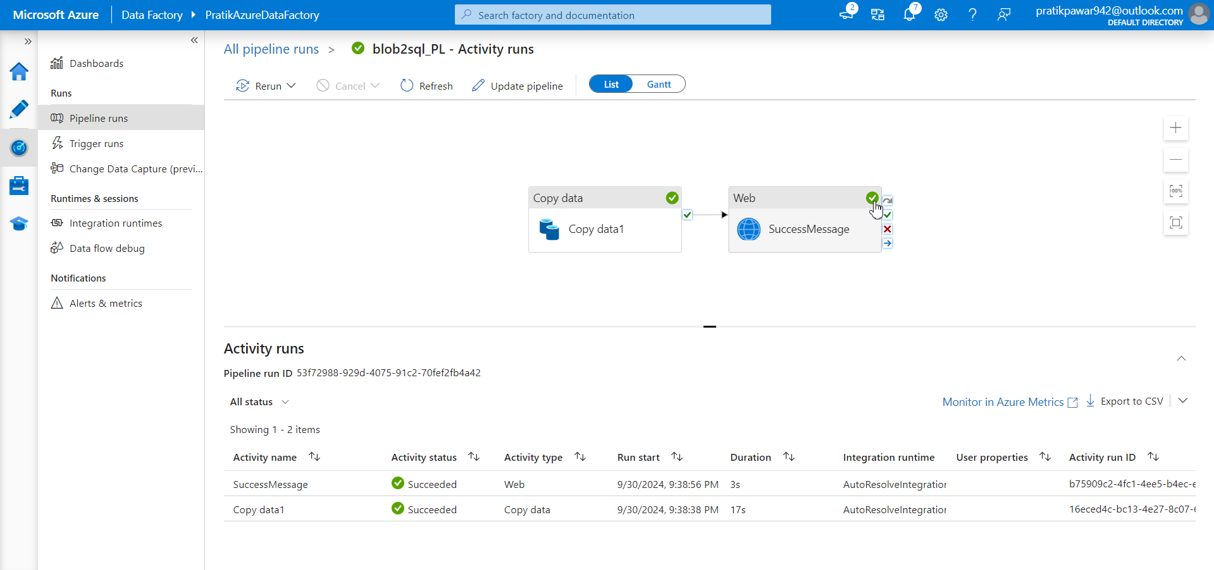
Now both correct sign is there then pipeline ran Successfully and email has been send to given emails list

Slide 51
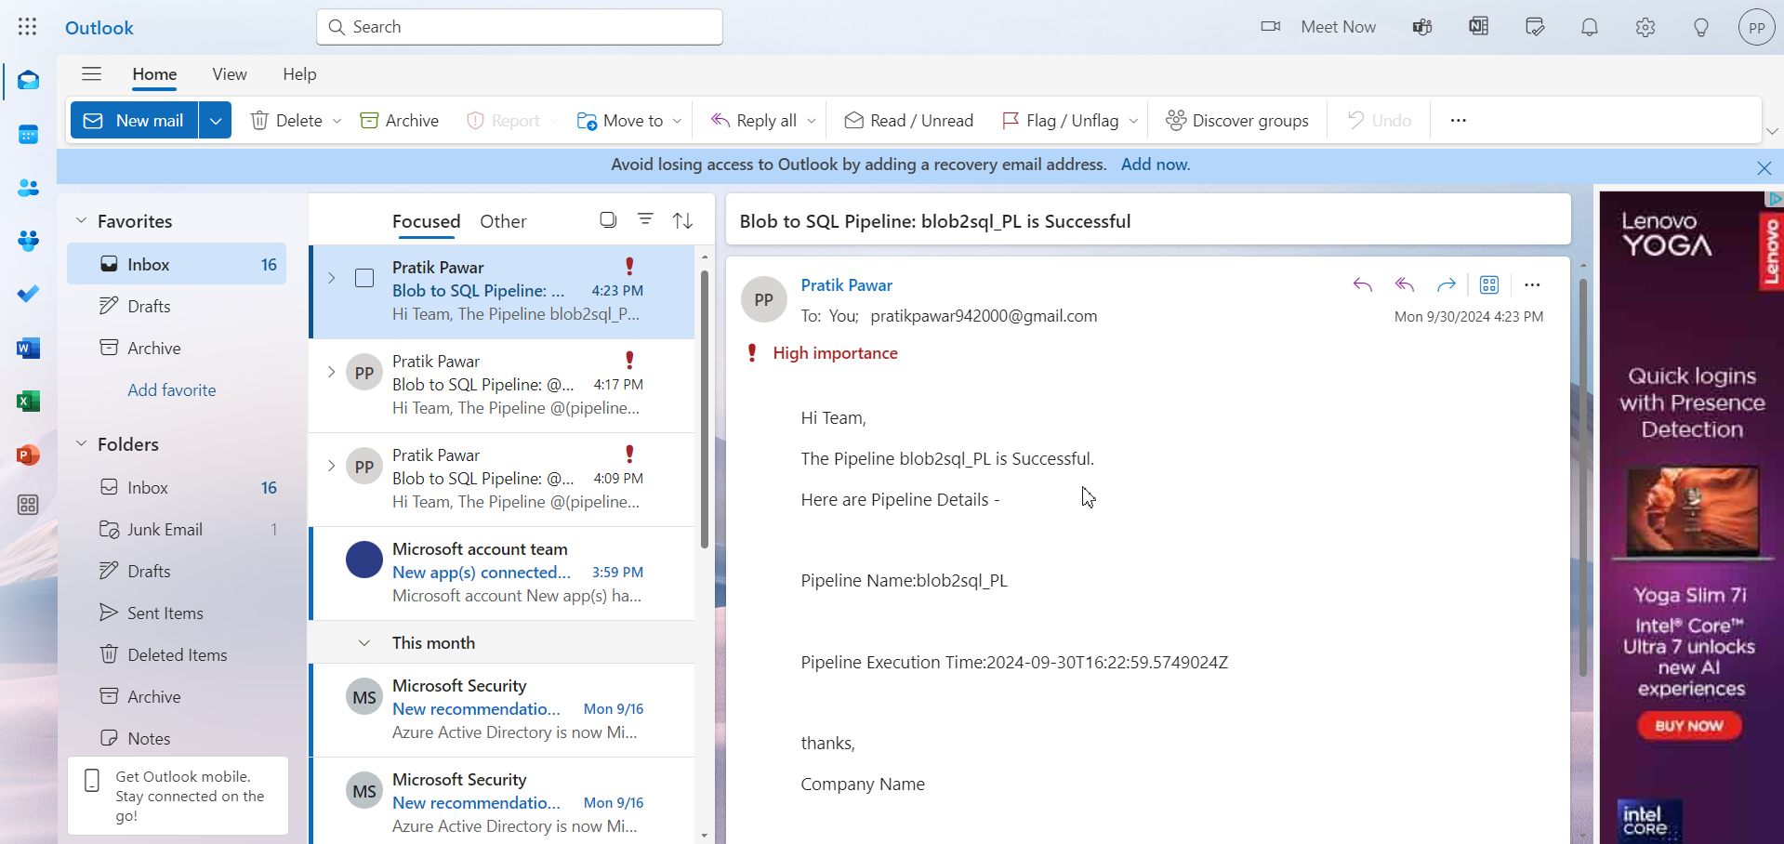
Here’s the email

Slide 52
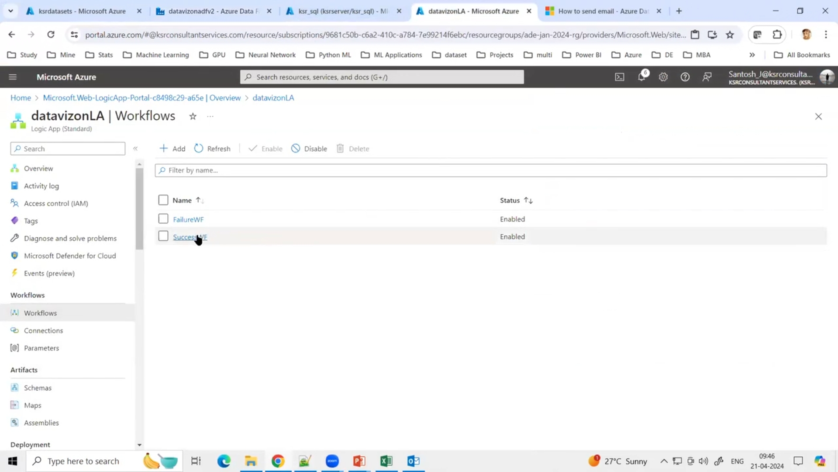
Go to Workflows add new failureWf to send email of failed PL

Slide 53

go to designer

Slide 54

Create same as SuccessWF and add pipeline error

Slide 55

Now create web activity as Failure Message and fill the settings

Slide 56

Connect it to fails

Slide 57

Body dynamic code

Slide 58
Create same flow as of success just add pipeline error

Slide 59

Paste the dynamic code from ADF to Logic apps

Slide 60
Fill all the data and run pipeline

Slide 61

After failure copy data activity gets cross and web ie failure message gets correct as it sends email of failure to respective people

Slide 62

Failure Email

Slide 63

Dynamic codes for failure and success

